Slide 1
Religion Policy and Faith-Based Organizations: Charting the Shifting Boundaries between Church and State Michael D. McGinnis Professor, Department of Political Science and Director, Workshop in Political Theory and Policy Analysis, Indiana University, Bloomington mcginnis@indiana.edu Paper URL: http://php.indiana.edu/~mcginnis/asrec_version.pdf Presentation Slides: http://php.indiana.edu/~mcginnis/asrec_slides.pptx
Presented at the 2011 Annual Meeting of ASREC,
Association for the Study of Religion, Economics & Culture,
Washington, D.C., April 7-10, 2011.

Slide 2
A Definition: A religion consists of an identifiable group of individuals who share all of the following:
Beliefs and doctrines, often related to things unseen or unknowable (especially what happens to human beings after death),
Rituals and individual religious experience (typically interpreted as encounters with the “other”),
Familiarity with symbols, stories, and modes of understanding (especially concerned with the meaning of life),
Reverence for sacred objects (scriptures, places, persons, things),
Social expectations shaped by codes of conduct (which typically differ for interactions with believers and non-believers),
Mechanisms for enhancing social ties and common experiences (often involving organizations for specialized activities),
Procedures for selecting and training leaders and making common decisions (both informally and within formal organizations),
Identification as members of a trans-generational community.

Slide 3
Points of Emphasis in Definition
Religion is inherently multi-dimensional: no one component is determinative or dominant.
Religion is inherently social, and cannot be reduced to individual beliefs or experiences.
Since religion is a collective activity,
it necessarily involves disagreements among its members (on any of its 8 component dimensions and on their implications for other matters, such as implications for practical policy concerns),
And the formation or operation of religious organization necessarily involves dilemmas of collective action,
And any successful instance of collective action by members of a religious community necessarily has consequences that affect others, even if these consequences are unintended side-effects,
In technical terms, religion generates externalities for society

Slide 4
Religious organizations can produce public goods for society as a whole:
charity: provide some public services at lower or no cost, especially to marginalized groups
morality: support general moral values, legitimize political regime, divert potential revolutions
prophetic voice: enhance public discourse, encourage reform towards peace and justice, alternate source of legitimacy
congregational form nurtures widespread experience in democratic self-governance (Tocqueville)
important source of volunteers for community engagement and of philanthropy
liberty: essential manifestation of personal liberty, freedom
Public “bads” include diversion of resources diverted from pressing concerns, and tendency to spread extremism & intolerance

Slide 5
FBOs (Faith-Based Service Organizations)
FBO: Faith-Based Organization: organizations that specialize in delivery of some particular form of service (food, shelter, education, health care, personal rehabilitation, etc.) and that base some aspects of their programs on religious inspirations or personnel.
An FBO can be affected by religion in one or more ways, such as if
Mission goals of program are shaped by religious doctrine or beliefs
Content of service program includes religious rituals and/or stories
Intended beneficiaries are co-religionists or are targeted for conversion
Reliance on financial support from religious organizations and/or donors
Implemented by hired staff or volunteers from a religious community
Religious specialists are managers or form majority of oversight board.

Slide 6
Extent of Faith-Based Contributions in Selected Issue Areas
Assessment of FBO Contributions | Domestic Policy | Foreign Policy
Integrated into Public Policy Networks | Health Care Social policy (welfare) Immigrant support Anti-poverty | Humanitarian Aid Human Rights (esp. religious rights, anti-trafficking )
Important but Mostly Separate Operations | Education Media Anti-abortion activism | Missionary/Proselytism Transnational Communities Mediation and diplomacy
Sporadic Campaigns or Specialized Involvement | Rehabilitation (& job training) Community Development Environmental Issues (“creation care”) | Debt (Jubilee 2000) Social Reconciliation (esp. local) Economic Development
Minimal to Non-Existent FBO Contribution | Budgetary Issues Military, Homeland Security Infrastructure | Peacekeeping Operations Managing Global Commons

Slide 7
Generic Categories of Policy Instruments
Since religious activities have external effects (positive and negative externalities), public officials routinely use policy instruments to shape their incentives
Public policy involves efforts to encourage positive externalities and discourage or control negative externalities, esp. w/r public goods/bads
Public officials encourage some of religion’s effects and discourage others
They do so by using their standard array of policy tools (or policy instruments):
Legal protections and definition of their legal status as corporate actors
Regulation of their behavior in certain areas
Financial rewards or punishments (direct or indirect)
Symbolic rewards or punishments
Patronage and other rewards for partisan support
Direct production of (or other means of procuring) public goods
So there exists an area of policy that could be called religion policy
Religion Policy: How governments use policy instruments to shape incentives of religious organizations or to use them as part of public policy implementation
Definition: All legal, regulatory, financial, and symbolic activities undertaken by public officials that involve cooperation with leaders of religious organizations, or which have direct or indirect impacts on religion

Slide 8
Essential forms of government support for religion include
Public services: fire, water, property rights, etc., like any other citizen or corporate entity
Tax exemption for donations, like any other nonprofit, and sometimes more, as in property tax exemptions
Protection of free expression, including participation in the political process (like any other interest group, but with limits on tax exemptions)
Exemption from labor, environmental laws, etc. for purely religious purposes
Grants, contracts, vouchers: Direct or indirect funding for schools and social service programs
Enact policies or laws as reward for political supporters, like any other interest group or constituent supporters (including religious earmarks)
General laws reflecting majority religious preference, like Sunday closing laws
Criminalize sensitive practices by minority religions (polygamy, sacrifices) or that offend believers (anti-blasphemy laws, hate crimes legislation)
Legal protection for religious organizations, some with special protected status
Protect autonomy for religious decisions (some countries allow separate system of family law)

Slide 9
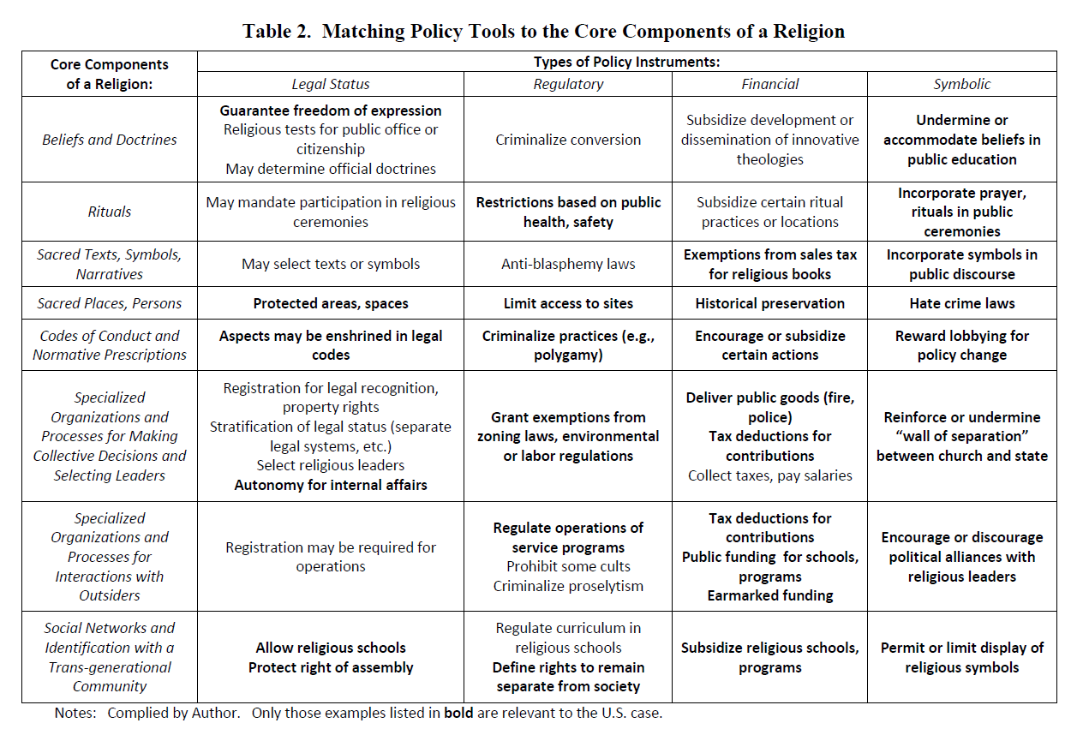

Slide 10
Charitable Choice and Faith-Based Initiatives: Background Information
Long historical tradition of religious participation in partnership with public agencies
Two recent initiatives of particular interest
Charitable Choice:
Section 104 in major welfare reform legislation (PRWORA) passed by Congress in 1996 and signed by Pres. Bill Clinton after a long battle (focusing on other provisions)
It was a relatively uncontroversial or unnoticed aspect of this reform, with no hearings, introduced by Sen. Ashcroft
Faith-Based Initiative
Executive Order of Pres. George W. Bush early in 2001, establishing Office of Faith-Based and Community Initiatives in White House and later in many branches of the Cabinet, including specialized agencies;
Designed to “unleash armies of compassion” and to “level the playing field for federal contracting”
No additional legislation could pass Congress
Many similar initiatives at state and local levels
Pres. Obama established Office of Faith-Based and Neighborhood Partnerships
Minimal changes in related programs

Slide 11
Faith-Based Initiative: Policy Goals and Instruments
FBOs (“armies of compassion”) could be mobilized to improve policy outcomes, because
Reliance on volunteer labor enables them to operate at lower costs
Integration of religious content into programs can improve effectiveness, by (1) more holistic approach to personal transformation, or (2) because front-line providers are more caring and less bureaucratic, or (3) giving converts a support network
Uniquely positioned to connect to hard-to-reach needy groups
Integrated package of policy instruments: religion policy in action
Legal: recognize rights of FBOs to implement programs as they wish, including suspension of anti-discriminatory hiring laws; yet also recognize rights of program beneficiaries to have access to non-religious alternatives
Regulatory: eliminate presumed bias of public officials against service organizations with strong religious connections
Financial: provide additional funds for new FBOs programs (while lowering overall level of welfare expenditures)
Symbolic: provide training programs and materials to facilitate application process, express support for religious participation in public policy in general

Slide 12
Charitable Choice and Faith-Based Initiatives: A Policy Evaluation
Critiques: each aspect of the basic rationale questioned by critics, except need for reform
Potential contribution was greatly exaggerated
Many FBOs were already involved in partnerships with government agencies
Little evidence of significant differences in content or effectiveness of FBO programs
Only anecdotal evidence of anti-religious bias
Those FBOs not already involved lack capacity to
(1) operate at large scale or
(2) handle required paperwork or
(3) may have good reasons to be suspicious of government interference
Motives of Bush administration suspect:
Intended to reward evangelicals and/or attract black votes?
Overall funding declined, leading to fears that public officials would off-load responsibility for public welfare as part of general trend towards privitization
Example: increase in FBO contracts from 11 to 12%, but decrease in overall budget
Lost support of religious groups offended by identity of some FBOs receiving awards
Consequences: meager impact on policy or votes, constant or declining funding levels
Yet the policy initiative survives into Obama administration,
So it must tap into something that resonates with important segments of public

Slide 13
Implications of FBO Integration in Policy Networks
Potential Benefits to actors within a policy network and to broader community
Cheaper implementation of some programs (volunteers)
Access to resources of religious organizations and individual donors
Access to suspicious, marginalized communities, and advocacy on their behalf
Other Benefits and Costs to actors within a policy network
Increased insulation from routine scrutiny of media and oversight agencies
Heightened vulnerability to scandals and to criticism from excluded groups
Continuing source of misunderstanding within the network
Costs to broader community
Misplaced priorities and unrealistic expectations of religious leaders
Mystification and diversion from practical considerations
Increased insulation from the close scrutiny of media and oversight agencies
Ineffective programs may continue to be funded
May reinforce divisions among religious communities, since the distribution of government support to religious programs cannot be fully equitable
May weaken separation of church and state in this and related policy areas
Additional Potential Benefits to broader community
Moral inspiration, legitimation, & persistence in intractable situations
Checks and balances: a uniquely efficacious constraint on excessive partisanship?

Slide 14
SUPPLEMENTAL SLIDES Estimating the Magnitude of Faith-Based Contributions to U.S. Welfare Policy (Excluding Health, Education, and International Components)
Steven B. Stritt, “Estimating the Value of the Social Services Provided by Faith-Based Organizations in the United States,” Nonprofit and Voluntary Sector Quarterly 37:4, December 2008, 730-742. All figures in 2006 dollars.
Congregations: $24.25 billion ($16.69b expenditures, $7.56b estimated value of volunteer labor)
FBOs: $25 billion ($20b National Network FBOs, $5b Freestanding FBOs)
Total Faith-Based Sector: approximately $50 billion
Total Governmental Expenditures on social services: $138.2 billion
Estimated from budgets of US Depts. of Agriculture, HHS, HUD, Labor
Of this, approximately 11.2% awarded to FBOs under competitive grants, so around $15b (out of the $25 billion budget of FBOs)
Estimated 1 in 6 service providers are FBOs, or 7,000 out of 42,000 (IRS data)
Total of $175b ($140b from gov, $35b or 20% from religious sources)
30% of expenditures go through FBOs (government or own funding)
Notes:
Inspired by question from a few students: What proportion of public services are run through FBOs?
This is an incredibly difficult question to answer, because there is no central clearing house for religious expenditures.
Data from the Stritt article cover only domestic programs, specifically in areas of social welfare and NOT education or health care.

Slide 15
Opportunities for Entrepreneurship in Religious Markets
Components | Variants | Opportunities
Beliefs and doctrines | Comprehensive to limited; Mysterious to rational/logical | Innovative doctrines
Ritual encounters with “other” | Intense/emotional to sedate/reserved; Frequent to rare; Emphasis on communal or individual | Make ritual experiences more intense and/or inviting
Symbols, stories | Extensive to simple; Mystical to plausible | Creativity within an established repertoire
Reverence for the sacred | Variety of sacred objects and intensity of reverence to each | Control can be lucrative; Connect to secular items
Codes of conduct | Strict to permissive; Exclusive to inclusive | New interpretations may conflict with old ones
Social ties | Dense/exclusive to loose/inclusive; Specialized service organizations | Small group activities; Establish FBOs
Organizations and Leaders | Radically egalitarian to hierarchical/bureaucratic | Many varieties developed within broad doctrinal limits
Community | Choice-based vs. determined by birth | “Invent” traditions

Slide 16
How is Religion Relevant to Politics, and Vice Versa?
Components of Religion | Related Matters of Concern to Public Officials | Opportunities for Policy Intervention
Beliefs and doctrines | Does religion support or undermine public culture? | Public education to reinforce societal norms (over religious)
Ritual encounters with the “other” | Distraction from practical concerns (for good or ill) | Encourage distractions or make religious activities illegal
Symbols, stories | Effects on citizen expectations; Framing of policy issues | Use religious symbols to support public goals or procedures
Reverence for the sacred | Locus of conflict; potential resource to be exploited | Exploit emotional intensity attached to sacred objects/places
Codes of conduct | Source of general morality and/or critique of authorities | Use as inspiration for new laws, or to legitimate existing laws
Social ties | FBOs engage in public services; (Cults may separate selves) | Encourage or undermine voluntary service organizations (and cults)
Organizations and Leaders | Rivals for allegiance and/or potential resource-rich allies | Appropriate religious property, or reward with policies or patronage
Trans-generational community | Potential rivals for primary loyalty of domestic groups | Connect religion with nation, or impose distance between them

Slide 17
Patterns of FBO Participation in U.S. Policy Networks
Domestic Policy Issue Areas
Social welfare: initially responsibility of churches and local governments, later national government got involved in partnerships with FBOs
Catholic, mainline Protestant FBOs integrated for long periods of time,
African-American Protestants later integrated in urban areas,
Evangelical Protestants especially suspicious of government involvement
Education: early schools taught Protestant Bible, Catholic schools established to protect immigrant communities, now many alternatives: public, private, Catholic, Lutheran, other Christian, home-schooling, with many controversies on role of religion
Health care: early involvement of religious orders, technical requirements have made public, religious, and for-profit hospitals increasingly indistinguishable
Job training, prisoner rehabilitation, and community development: uneven participation from religious organizations, closely connected to government or business programs
Foreign/Global Policy Issue Areas
Humanitarian relief: Long tradition of missionaries, later transformed into professionalized service providers well-funded by national governments and IGOs, expansion beyond just humanitarian aid; continued importance of proselytism by evangelical missionaries
Health care and education: early missionary efforts, current system not well-integrated
Development assistance: Religious NGOs slow to emphasize long-term development
Peace and reconciliation: traditional peace churches and local inter-faith coalitions

Slide 18
Linking Policy Instruments to the Core Components of Religion
Beliefs and Doctrines
Protect freedom of religious expression
Religious test for office (early states)
Criminalize proselytism or conversion
Undermine or accommodate religious beliefs in public school curriculum
Rituals
Coerce participation in church services
Criminalize rituals to protect order, safety
Grant exceptions from criminal law for selected rituals (ex: drugs)
State-sponsored prayer at public events
Symbols, Stories, Sacred Texts
Accommodate usage of generic phrases of majority religion (so help me God, etc.)
Use religious symbols in civil ceremonies
Sacred Places, Persons
Tax exemptions for religious organizations
Protect churches from zoning laws or sacred sites from public takings
Enforce anti-blasphemy laws (hate crimes)
Codes of Conduct
Enact moral codes into law (prohibition, abolition, anti-abortion)
Encourage or subsidize faith-based service programs (welfare, hospitals, relief)
Criminalize behaviors to protect order, safety (example: plural marriage)
Processes for Collective Decisions, Leaders
Defer to autonomy of religious organizations (leadership, property, doctrinal disputes)
Separate legal systems
Identification with Transgenerational Community
Allow religious schools to operate, subsidize them directly or indirectly (vouchers)
Allow or subsidize release time from public school for religious instruction
Allow or prohibit visible symbols of religious identification (headscarves)
Social Networks
Protect right of assembly
Allow or prohibit religious political parties
Allow deprogrammers to target cults

Slide 19
How Policy Priorities of Religious Communities Change with Relative Size
Relative size and status of religious community can make a huge difference
Very small religious communities emphasize self-protection, mutual aid , and perhaps isolation (example: Amish)
Minority communities subjected to discrimination may unite for self-defense (example: long-standing importance of African-American churches) or fight to protect minority rights (example: traditional Jewish support for civil rights)
Moderate sized communities may fear absorption into majority culture (example: Catholic immigrant communities establish system of parochial schools)
Larger and more secure communities may welcome partnership with public officials (example: Catholic charities later integrated into policy networks, along with mainline Protestant denominations)
Dominant communities may seek hegemonic influence over rest of society (example: early common schools relied on Protestant version of Bible, recent resurgence of efforts to define America as a “Christian nation”)
Attitude of public officials are affected by exactly these same factors

Slide 20
How Policy Priorities of Religious Communities Change with Relative Size (slide 2)
Size of Religious Community: | Very Small | Moderate | Predominant
Worship and Proselytism | Unlimited religious freedom and innovation | Freedom of expression for recognized faiths; Regulate cults or minority faiths | Incorporate religious symbols in civil ceremonies; Limit proselytism
Education | Self-protection, exemption from public education | Support private religious schools to protect moral values | Impose religious values and beliefs in public curriculum
Social Services | Self-help; Services focused on fellow believers | Outreach to rest of community; Potential basis of separatism | Potential rival to state’s ability to reward supporters
Advocacy | Withdrawal from society | Moral campaigns; Opportunistic coalitions | May undermine state authority
Institutional Interests | Protect privacy and right to violate social norms | Limit government intervention in all religious matters | Protect accumulated property; Establish theocracy

