Slide 1
“Institutional Analysis as a Foundation for Multi-Tier Game Models” Michael D. McGinnis Professor, Political Science and Co-Director, Workshop in Political Theory and Policy Analysis Indiana University, Bloomington mcginnis@indiana.edu
Presentation at Institutional Analysis and Development Symposium,
School of Public Affairs, University of Colorado Denver,
April 9-10, 2010
Draft – April 6, 2010

Slide 2
Overview of Presentation
Why are game models so important for policy analysis?
How do they tend to be used, and why?
What contributions have scholars using the IAD Framework made to our understanding of the policy lessons of game models?
Lessons from experiments in laboratory settings
Connections to formal models and field studies
Conceptual innovations
Action situations at operational, collective, and constitutional choice levels of analysis/arenas of interaction
Grammar of institutions (strategies, norms, rules, positions)
What opportunities remain to be explored?
Building explicit models of multi-tier games (beyond two-level or nested games to complex networks of adjacent games)
Ideas beyond this draft: ABMs, learning norms and heuristics
Enhancing potential policy relevance by problematizing the continuing hegemony of the Nash equilibrium concept

Slide 3
Why Are Game Models So Important for Policy Analysis?
Game models are most useful to represent situations in which
Outcomes are jointly determined by decisions made by a relatively small number of separate actors,
Different actors have different resources, capabilities/options, information, or modes of making decisions available to them,
But these differences can be usefully summarized into a small number of simple alternative choices or types,
Actors evaluate potential outcomes differently (especially mixed-motive situations, where actors share some interests in common, but not all),
Actors are capable of evaluating the likely consequences of their actions, and can take these consequences into account in making their decisions,
At least some actors are capable of thinking strategically (i.e., taking account of the possible effects of their choices on the choices of others, and vice versa),
All this is sufficiently important to at least some of the relevant actors that they are willing to invest the time and effort to obtain better results (and thereby can be expected to reach an equlibrium).
Many policy settings can be usefully conceptualized in this way

Slide 4
Generic and Specific Models
Game models come in two major variants:
“Heuristic models” of generic situations that recur in different empirical contexts (coordination games, prisoner’s dilemma, chicken games)
Specific institutional settings in which rules specify the options different actor-positions have and the sequence in which they act, and the status quo point
Generic models are especially useful to highlight recurring patterns or dilemmas, and to classify the range of potential responses
Some games are familiar to scholars in many fields (esp. PD)
Specific models enable institutional analysts to focus on the consequences of particular institutional details and learn how minor changes in such details can lead to dramatic changes in outcomes
Predictive value of models limited if players are able to change those details in real settings, once they realize their implications
Most experiments testing game predictions in laboratory settings are inspired by generic models, but results must be interpreted with careful attention to the specific setting of that experiment
Need more tests of proposed reforms in laboratory settings (policy test-beds)

Slide 5
Overview of IAD Games
Long tradition of using experiments to test predictions of games: voting, public goods, common pool resources, trust
Correspondence to theoretical predictions varies by institutional context
Experimental subjects bring norms & social expectations to the lab
Innovative work testing similar games with US college students and members of local communities in LDCs
Effective complement to findings from field studies
Self-governance can be replicated in laboratory settings
“Cheap talk” can be effective (face-to-face communication)
Endogenously enforced sanctions can be very effective
Many models developed, some very specific and complicated
CPR models in Rules, Games, and Common Pool Resources
Ostrom-Weissing on monitors in irrigation systems
Acheson-Gardner on rise of territoriality in Maine lobster fisheries

Slide 6
Example: Acheson-Gardner Model of Territoriality
Basic conditions of game:
Lobsters limited mobility, but predictable seasonal patterns
Found especially near harbors, costly to fish in open seas and lower returns
Some harbors sheltered, and tight communities, others more open, sparsely populated
Specific model includes only two harbors
Player options (A) to stay at home or invade neighboring (more productive) area, and (B) to ignore invasion or to protect/cut traps
Predict typical pattern of three-fold territoriality: Protected territories in small bays where fishers live close together, mixed system of multiple users in some bays resulting in conflict and losses, and no conflict far from shore
Within a bay: If defense (monitoring and cutting traps) is not too costly, then no invaders; otherwise some do invade
In mixed areas: If fighting doesn’t pay, then no monitoring or sanctioning; If fighting does pay, then some conflict and losses are triggered by cutting traps and retaliation
Eventually the area is too large to be cost-effective as a protected area and fishers are unable to recognize all participants so no collective action
State, national, or international authorities may not recognize or allow local rules (such as cutting traps), so system is vulnerable to being undermined

Slide 7
Unrealized Potential of IAD Conceptual Innovations
Distinction among operational, collective, constitutional choice levels (or arenas of interaction) is relatively well-known,
Few ties to literatures on two-level games or nested games
No examples of explicit models linking across levels/arenas?
Action situation in IAD Framework as generalization of rules of a game, but not widely adopted as such
Grammar of institutions less frequently applied
Fundamental similarity of strategies, norms, rules, positions/roles as part of the repertoire available to participants
Role of public entrepreneurs in expanding this repertoire
Future developments:
application to social-ecological systems
polycentric networks of game models

Slide 8
Fig. 1.
Multi-Level Representation of IAD Framework

Slide 9
Games of Operational, Collective, and Constitutional Choice
Theme: Institutional setting determines the actions available to players in positions (and their evaluations of possible outcomes), as well as their capacity/inclination to engage in strategic behavior
Operational Choice:
Example: head-enders and tail-enders draw water from an irrigation system that requires both to contribute towards maintenance of that system
In any situation, at least some actors may act selfishly, to maximize their own utility.
Collective Choice:
Example: choosing rotation schemes, or which voting system to use in particular settings
Actors with different interests/perceptions interact as they shape the institutional setting for subsequent operational choices
Institutions should be designed so as to be able to cope with instances of opportunistic behavior by actors in the operational choice arena
Constitutional Choice:
Example: Constitutional convention in Philadelphia
Long-term perspective on how different organizations are likely to interact over time, combined with the practical need to compromises with current power holders
Meta-Constitutional Choice
How might societies establish a “just” order, given the nature of human behavior?
Example: Rawls’ “veil of ignorance”?; Sen’s entitlement perspective?

Slide 10
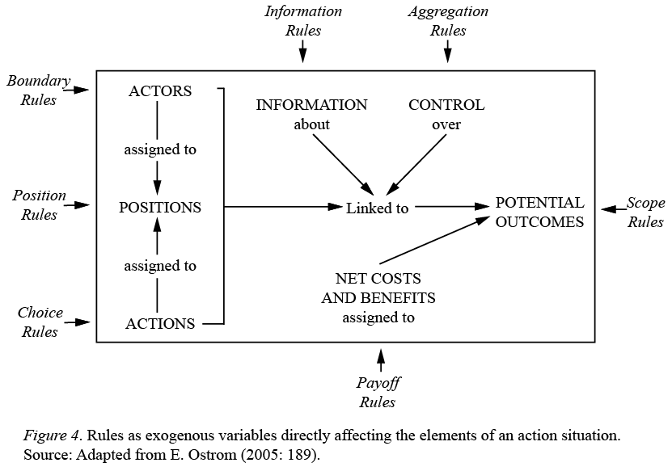
Fig. 2.
Working Parts of an Action Situation and Associated Rules

Slide 11
Games, Action Situations, and Adjacency
Rules of a game can be generalized to “working components of an action situation” (Ostrom 1986, 2005)
Game: players, choices, strategies, outcomes, payoffs, information
Action Situation: actor/participants, positions, choices/actions, control/action-outcome linkages, potential outcomes, costs & benefits, information
An action situation “embeds” a game within its institutional context by emphasizing that the “rules of a game” come from somewhere
Each working component may be determined as outcomes of other action situations
Or they may be changed by the participants themselves
Self-governance: Individuals can influence the institutional context within which they decide, especially when acting jointly with others
Adjacency of action situations as potential basis for future elaborations
Treat working components of a given action situation as the outcomes of processes occurring in “adjacent” action situations
Rules of one game are determined by outcomes of adjacent games

Slide 12
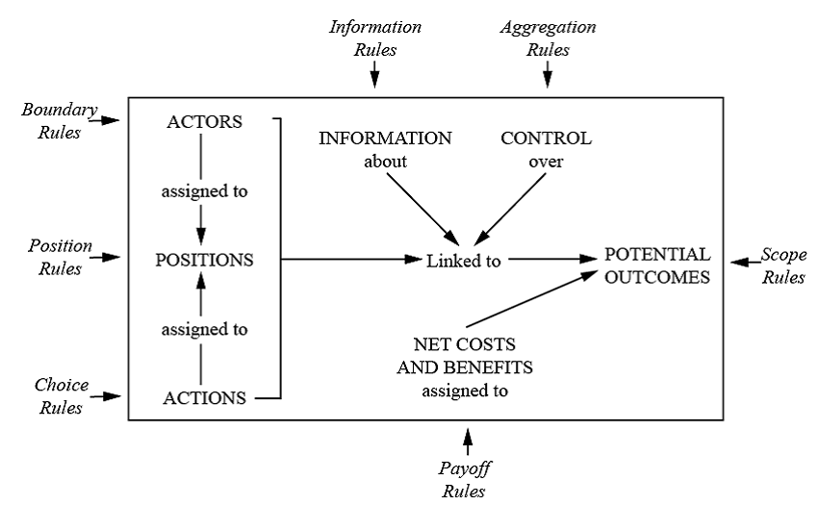
Games Adjacent to an Action Situation, with Examples of Connections to Working Parts and Associated Rules
Rules Governing Distribution of Information to Actors
Processes that Generate Relevant Information
Nature of Good (Functional Relationship between Actions, Outcomes)
Actions of Other Groups which Directly Affect Outcomes
Definition of Official Jurisdictions
Group Formation and Identity
Appeals to and Effects on External Actors
Construction of Positions and Collective Actors
Subsequent Iterations of Similar Situations
Repertoire of Policy Options Known to Actors
Generation and Dissemination of Culture and Norms
Markets and Other Valuation Processes
Source: Interior figure taken from Ostrom 2005: 189; additional components added.

Slide 13
Networks of Adjacent Action Situations
Complications arise quickly:
Multiple adjacencies, overlapping games/action situations,
Some changes can be made by participants in focal game, others can be imposed from outside, some involve overlapping actor sets
But no one has ever said that self-governance (or institutional analysis) is either easy or low-cost
In some settings the focal action situation is relatively autonomous
If many & dense ties between adjacent games, they may effectively merge
Many CPR examples studied by Workshoppers are relatively self-contained systems, far removed from national centers of power or economy
Some adjacent action situations are more critical than others
Subsequent iterations as basis for repeated game analyses
External intervention: higher authorities, other actors, market value
Information generation and distribution
Repertoire of strategies, norms, rules, and positions

Slide 14
From Grammar to Repertoire of Institutions
Crawford-Ostrom ADICO grammar:
Strategies, norms, rules are institutional statements
Grammatical components Attributes, Deontic, aIm/target, Conditions, Or else.
Let’s follow this line of logic a bit further
Rules require definition of “positions or roles” with responsibility to monitor behavior and enforce rights and/or sanction violators (rule-selectors or rule-enforcers)
Norms need to come from somewhere (broader socialization processes guided by parents, educators, and other position-holders), and to be applied to particular situations, perhaps by some recognized opinion leader or norm-interpreter
Implementation of contingent or coordinated strategies typically requires some common source of information or cues, perhaps from a signal-sender
Public entrepreneurs can play roles of signal-senders, norm-interpreters, or rule-monitors/enforcers: position-holders as a generic term
Where do the strategies come from? Also from efforts of public entrepreneurs, plus remembered history
Dynamic repertoire of strategies, norms, rules, positions in any game
Focus on flow of information through any game or action situation
Actors form expectations of other’s behavior, as affected by choices of position-holders

Slide 15
Next Steps: Understanding Networks of Adjacent Action Situations
This paper needs a new title.
“Multi-level or multi-tier” games is better than “two-level or nested” but still not fully appropriate for polycentric arrangements
I coined “polycentric games” for one of my edited volumes, but it never caught on and, frankly, it’s confusing
Games on “networks of adjacent action situations” (NASS ?)
Draws on developments in the emerging literature on “games on networks”
Incorporates effects of networks of social or other ties among game players,
Players may choose to establish a new link or sever an existing one,
Equilibrium conditions relate to network structures as well as outcomes.
Here we need games on networks of adjacent action situations, or adjacent games, in which players can change conditions of their core game
Define action situation X_{i} as “adjacent to” Y if the outcome of X_{i} directly influences the value of one or more of the working components of Y
Does NASS bridge the generic-specific divide?
A game on a network of adjacent action situations is more than just the bare mathematical skeleton as represented in a game matrix or game tree
Analysts must know enough about the application or manifestation of the underlying game structure to identify the most potentially relevant adjacent action situations

Slide 16
Alternative NASS Versions of the Prisoner’s Dilemma Game
Original motivating story: DA / prosecutor defines situation; prisoners are trapped
Prisoners can’t communicate, but may already be connected by norms (honor among thieves) or rules (enforced by gang members in prison or on family?)
Would a competent DA try this if this threat is credible? Witness protection?
Arms Race: rivals each face opportunity costs of defense-welfare tradeoff
Long-term relationship, so may use reciprocal strategies to sustain arms control, facilitated if parties can improve access to information; can become intrusive
Not a dilemma if both sides dominated by military-industrial complex (Deadlock)
Public Goods: Some potential directions towards a “solution:
Hegemon or Olsonian privileged group with encompassing interest
Smaller group may have sufficient ties to exert social pressure, esp. for club goods
Local public goods: Tiebout and Ostrom-Tiebout-Warren
Reliance on public authority viable only if secure taxing capacity already exists
Hardin’s tragedy of the commons: privatization and central control as only options?
Are parties trapped in situation, helpless, with no capacity to learn?
Or do conditions facilitate success of communal governance? If so, to which conditions are they most likely to use as foundation of self-governance?
Each context directs attention of analyst to different adjacent action situations

Slide 17
Navigating the Network
To change the network, participants must consider the potential benefits and costs of implementing change. Although no participant (nor external analyst) is capable of making these calculations in full, they can form rough estimates of relevant factors:
Expected up-front costs of devising and agreeing upon new rules;
Expected short-term (or start-up) costs of implementing new rules
Expected changes in operating costs (monitoring, sanctioning) of new scheme
Likelihood that proposed change can be effectively implemented
Expected improvements in benefits if this proposal works as planned
Analysts may make predictions about most likely changes to be proposed and/or implemented, based on cost structure and decision-making processes
Begin analysis by identifying action situation Y as focal level
Highlight sequence of information flow through Y
Identify most directly relevant adjacent action situations
Participants make proposals in terms of changing the outcome of some adjacent action situation, drawing from own experience or knowledge
Participants face varying degrees of expected costs (and potential benefits) in contemplating changes in any of the relevant adjacent action situations X_{i}

Slide 18
Learning Loops from Maine Lobster Fisheries (Acheson)
Historical stages of development
“Harbor gangs” emerge from long-standing social communities
Assert exclusive right to harvest lobsters from areas close to shore
Cut traps with graduated levels of obviousness as signal to violators
Endogenous development of practice of cutting V-notches in egg-bearing females and limits on size of lobsters that can be harvested;
Practice expanded through boycott of buyers who violate these rules
Environmental scientists and activists rarely appreciate efforts of lobster fishers to conserve resource
State authorities impose similar conservation restrictions, most of which were the result of lobbying by lobster industry.
National authorities claim sovereignty over areas 3-200 miles off shore
Neither state nor national authorities recognize rights claimed by “harbor gangs” and have made cutting traps illegal.
Mixed fishing zones began to develop in 1930s with adoption of larger, faster boats.
By 1970s mixed zones expanded as state authorities began to undermine local enforcement activities and lawsuits filed when traps were cut
Future potential problems?

Slide 19
Generic Learning Loops in SES Action Situation
Routine adjustments: Participants change their actions but within their same overall strategy (or adopt a strategy used by others)
Change strategy: Participants devise and implement a new strategy for themselves
Convince position-holders (rule-enforcers/norm-interpreters/signal-senders) to change their decisions/suggestions/instructions
Change position-holders: Use existing collective choice procedures to select/appoint a new rule-enforcer/norm-interpreter/signal-sender
Change selection process: Collectively revise the process through which new position-holders are selected and/or new positions defined
Expand repertoire: Collectively revise rules, norms governing this group, which may require innovation of new positions of authority
Change group goals: Collectively change the shared goals/mission of the group
Expand/contract group: Agree to open up membership in the group to others who also have important effects on key outcomes, or limit to cooperators
Appeal for redress of grievances to “higher” authorities, or make a deal with powerful outside actors
Lobby (or bribe?) “higher” authorities to recognize and respect locally devised norms, rules, and procedures
Note: Options are arrayed in approximate order of increasing costs in time or effort, but specific cost orderings will vary by situation.

Slide 20
Possible Lines of Development (not in this paper)
Agent-based models
Useful way to study dynamic processes in a networked setting
See Janssen and Ahn 2006 Ecology and Society; Poteete, Janssen, and Ostrom 2010, Working Together, Princeton U. Press
Forces analysts to specify decision-making and learning processes
Actors “learn” norms and heuristics
All situations uncertain or risky
Norms are necessary for but not sufficient as explanation for cooperation
Learn a norm by “attaching an internal valuation – position or negative – to taking particular types of actions in specific situations” (PJO, ch. 9)
Include heuristics in repertoire of strategies, etc.
Trust and reciprocity as critical intervening variables
Incorporate research findings on effects of key micro-situational variables

Slide 21
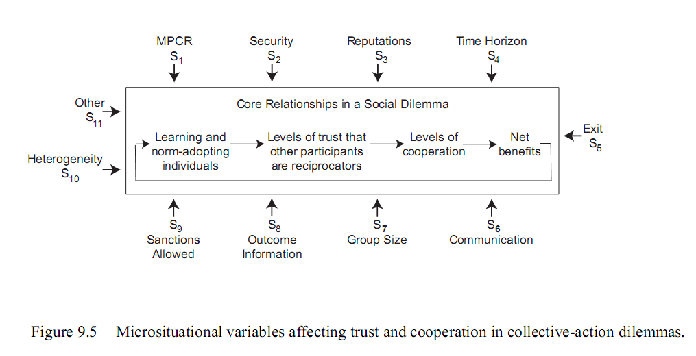
Micro-situational Variables as Inputs to Learning Processes (PJO 2010)

Slide 22
Micro-situational Variables (PJO 2010)
Directly Positive Effect on Trust and Cooperation
High marginal per capita return of cooperation (mpcr)
Security that insufficient contributions will be returned
Reputations known
Longer time horizon
Easy entry, exit
Communication feasible with all participants
Nonlinear, or Cinderella Effects (not too hot or too cold)
Size of group
Information about average contributions are available
Sanctioning capabilities
Heterogeneity in benefits and costs

Slide 23
Conclusion: Problematizing Nash in a Polycentric World
In this conceptualization, game players/action situation participants face complex array of options involving changes in outcome of adjacent games
It may be possible to develop a systematic list of the relative appeal of alternative moves likely to be considered by actors in a given situation
If we can devise modular game formulations of information generation and use
Nash equilibrium is a compelling statement of “rational” behavior, but not necessarily in all contexts
Nash equilibrium consists of mutual best responses based on assumption that other players continue to implement their current strategy
Appropriate for generic contexts in which no one can be certain that others will live up to their commitments
Appropriate if players are trapped and are unable to make any meaningful changes in the conditions under which they interact
But what changes when players begin to develop relations of trust?
When presented with a game structure, players actively try to change it
Critical insight for analysis of implementation
Polycentric governance arrangements give individuals and groups regular access to options to change the conditions of their own existence
Is Nash equilibrium appropriate for anyone living in a polycentric world?

