Slide 1
Shared Stewardship of a Health Commons: Lessons from the Managing the Health Commons Research Project Michael D. McGinnis, Ph.D. ReThink Health, Fannie E. Rippel Foundation, and Ostrom Workshop in Political Theory and Policy Analysis, Indiana University mcginnis@indiana.edu
Webinar for Alliance of Community Health Plans (ACHP), Oct. 16, 2012
Managing the Health Commons is part of ReThink Health (http://www.rethinkhealth.org/), a collaborative research and action initiative funded by The Fannie E. Rippel Foundation (http://www.rippelfoundation.org/).

Slide 2
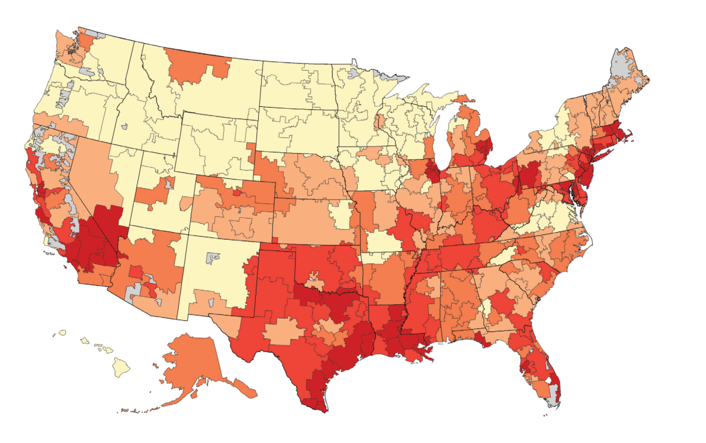
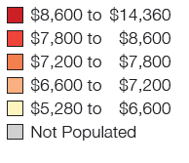
Health Care is Local
Medicare Spending per Beneficiary, 2005
There us a wide range of regional variation in cost and utilization.
Can this be a basis for transformative reform?
Local/regional stakeholders who establish informal mechanisms of collaboration can share responsibility for stewardship of their community’s resources for health care and health promotion.
We use Elinor Ostrom’s Nobel-prize wining research on community-based management of common resources to investigate conditions which can support shared stewardship of local health commons.
Source for Map: Wennberg, John E., Shannon Brownlee, Elliott S. Fisher, Jonathan S. Skinner and James N. Weinstein. 2008. Agenda for Change: Improving Quality and Curbing Health Care Spending: Opportunities for the Congress and the Obama Administration, A Dartmouth Atlas White Paper, December 2008.

Slide 3
What is a Commons?
A commons is a collection of natural or constructed resources that is available for use by a specified group:
Some aspects of the commons are public goods that can be enjoyed by all members in common, some are club goods available only to those satisfying certain conditions,
Other aspects are common pool resources, meaning that resource units extracted from the commons can become the private property of the person doing the extracting.
Any commons requires replenishment and/or maintenance.
Depending on extraction levels and resources allocated to maintenance or replenishment, a commons may be depleted or remain sustainable, and
Rules specifying restrictions on extraction levels and contributions can be written, monitored, and/or enforced by members of that group or by others, in diverse combinations.
3

Slide 4
Micro-Commons Relevant to Health or Health Care
All communities have established programs addressing the many segments of overall health:
Community Clinics (Medicaid/Sliding Fee)
Health/Wellness Initiatives
At-Risk Youth Initiatives
Assistance Programs
Recreation Resources
Behavioral Health Initiatives
Health Care Plans and Provider Networks
Each micro-commons has rules on access and the replenishment needed to prevent overuse and degradation of resource.
4

Slide 5
Design Principles (Governing the Commons, Elinor Ostrom 1990)
A community can sustainably manage a pool of common resources if
The group and resource in question have well-defined boundaries
And the group has sufficient capacity and autonomy to
Collectively craft rules limiting levels & modes of resource extraction,
Gather information via routine monitoring of user actions and resource outcomes,
Use that information to impose graduated sanctions on rule-breakers,
Resolve disputes directly or with the help of intermediaries,
Form sub-groups to focus on particular problems, and if
These rules and procedures are appropriate for local circumstances and are seen by group members as fair (since they distribute the costs and benefits of collective action in an equitable manner).
Plus two requirements that were implicit in Ostrom’s original list:
Members of this group have long-term dependence on this resource
Effective leadership is exerted by trusted members of that group.
5

Slide 6
Applying the Design Principles to Health Micro-Commons
Long-Time Horizon | Share a compelling goal to fill some gap in the system.
Clear Boundaries (system) | Stakeholder involvement determined by program needs.
Autonomy (and capacity) | Grant funding is fine initially, but parties should avoid continued dependence on external program funding.
Participation in rule-making | Explicit norms for open discussion are established early.
Monitoring | Significant time & effort is devoted to data collection, evaluation, and group learning.
Graduated Sanctions | Hold parties accountable but allow minor exceptions.
Dispute Resolution | Resolutions should sustain high levels of mutual trust.
Rules appropriate for local conditions & seen as fair | Programs may need meaningful participation by non-professionals.
Nested enterprises | Focus attention on meaningful, interdependent tasks.
Legitimate leaders | Give specific individuals clear responsibility for each program initiative.
6

Slide 7
Moving to the Macro-Level
There are multiple commons within the health care sector.
At the macro-level, a health commons encompasses the broad array of physical, financial, human, and social capital relevant to health care and/or population health.
By shared stewardship we mean the collective management of a community’s resources so as to make the most effective use of those resources for the benefit of that community.
Shared stewardship can take place in different ways, from informal coordination to fully integrated systems.
Collaboration typically begins with relatively small projects, and over time it may grow to cover more complicated issues.
The challenges faced by different regions tend to be more similar than their responses.
7

Slide 8
Design Principles for Shared Stewardship of the Macro-Commons
Original | Regional Stewards (informal) | Regional Stewards (integrated)
Long-Time Horizon | Share high aspirations for transformational change . | Credible buy-in from key local leaders and corporate executives.
Clear Boundaries (system) | Form a real team of diverse stakeholders: bounded and stable group (few absences, substitutes) . | Key providers, payers, and public health officials are all actively engaged; keep adding new partners whenever needed.
Autonomy (capacity) | Build on existing stock of social capital. | Assert local ownership of health care delivery system.
Participation in rule-making | Beginnings matter; establish norms of open discussion early in process. | Build and reinforce trust that discussions remain confidential.
Monitoring | Begin to collect data systematically and share widely. | Regular assessment of community needs and capacities.
Graduated Sanctions | Hold parties accountable but allow resets and re-starts, out of respect for divergent missions of stakeholders. | Make allowances for constraints on local stakeholders in consolidated systems.
Dispute Resolution | Discuss fairness concerns openly and respectfully. | Resolve conflicts internally, avoid politicization of disputes.
Rules appropriate locally & seen as fair | Prioritize specific and achievable goals to build momentum. | Reinvest shared savings on further improvements.
Nested enterprises | Neighborhood-initiated programs should be encouraged. | Focus on filling in remaining gaps in coverage or evaluation.
Legitimate leaders | Convener and sponsors need moral authority. | Public views decision procedures as accountable and inclusive.
8

Slide 9
Enabling Conditions for Regional Stewardship
Individual Leaders
Commitment to transformative change
Openness to new ideas
Skills of listening, collaboration
Long time horizon; ethos of stewardship
Take responsibility for delivery system
Individual Citizens
Take responsibility for own health
State/National Context
Encourage local autonomy and responsibility
Make resources available for innovative programs
Support research and disseminate best practices
Support cross-regional learning communities
Consider sustainability of reforms and regulations
Political discourse supports realistic expectations
9

Slide 10
Aligning Corporate Interests and Shared Stewardship
Design Principles | Corporate Characteristics
Long-Time Horizon | Managers incentivized to look beyond short-term returns.
Clear Boundaries (system) | Mission priorities encompass community benefit (“enlightened self-interest”).
Autonomy (capacity) | Local units in consolidated systems retain significant decision autonomy.
Participation in rule-making | Providers encourage shared decision-making.
Monitoring | Collect and utilize data on quality performance.
Graduated Sanctions | Compensation affected by quality of performance.
Dispute Resolution | Cooperate with other local organizations through contracts and more informal means.
Rules appropriate for local conditions & seen as fair | Implement meaningful and long-term programs on community outreach.
Nested enterprises | Commit significant resources for quality improvements and other innovations.
Legitimate leaders | Top executives support cooperative programs.
10

