Slide 1
Shared Stewardship of a Health Commons Michael D. McGinnis, Ph.D. ReThink Health, Fannie E. Rippel Foundation, and Workshop in Political Theory and Policy Analysis, Indiana University mcginnis@indiana.edu
ReThink Health: Leading & Collaborating for Change
Mini-Course, Dec. 5, 2011 (Revised Jan. 10, 2012)
23rd Annual National Forum on Quality Improvement in Health Care
Institute for Healthcare Improvement (IHI), December 4-7, 2011, Orlando, Florida

Slide 2
Research Collaborators
Managing the Health Commons team at Indiana University
Michael D. McGinnis, Ph.D., Professor, Political Science, and Principal Investigator, Managing the Health Commons project
Elinor Ostrom, Ph.D., Distinguished Professor, Political Science and Public and Environmental Affairs
Joan Pong Linton, Ph.D., Associate Professor, English
Claudia Brink, MBA, MPA, Ph.D. candidate in Public Policy, and Assistant Director, Workshop
Carrie Ann Lawrence, Ph.D. candidate in Health Behavior
Ryan Conway, Ph.D. candidate in Political Science
Other research and research-action teams in the ReThink Health initiative (http://www.rethinkhealth.org/), funded by The Fannie E. Rippel Foundation (http://www.rippelfoundation.org/).
2

Slide 3
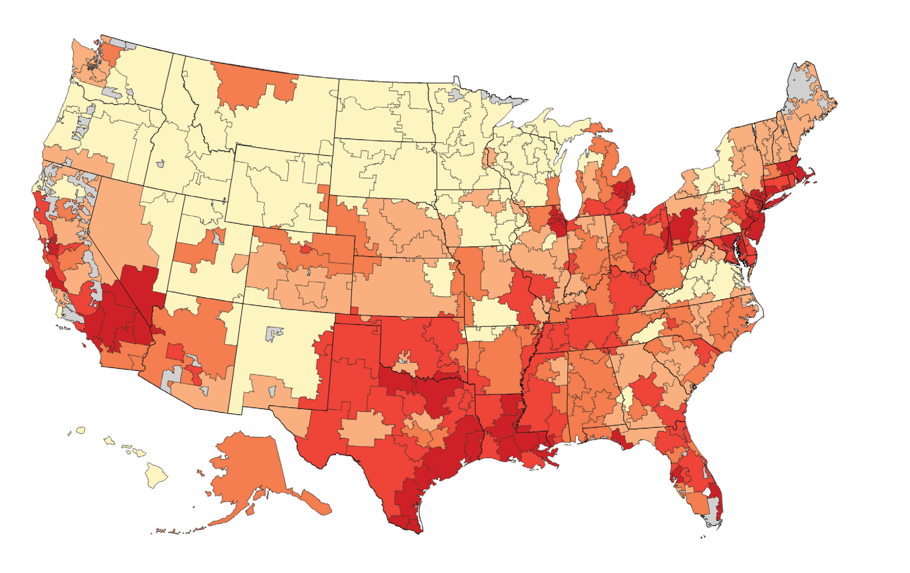
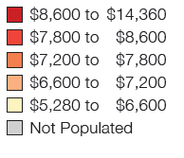
Health Care is Local
Medicare Spending per Beneficiary, 2005
Wide range of regional variation in the USA.
Unusually successful communities developed informal mechanisms of collaboration at the regional level.
Stakeholders can share responsibility for stewardship of common resources.
Source for Map: Wennberg, John E., Shannon Brownlee, Elliott S. Fisher, Jonathan S. Skinner and James N. Weinstein. 2008. Agenda for Change: Improving Quality and Curbing Health Care Spending: Opportunities for the Congress and the Obama Administration, A Dartmouth Atlas White Paper, December 2008.

Slide 4
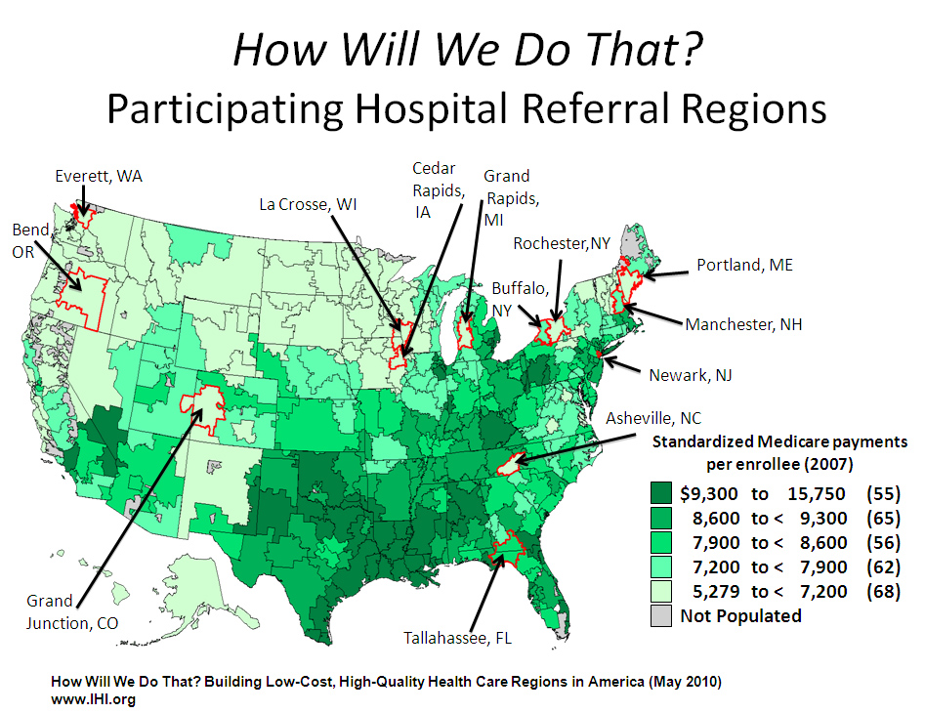
A Regional Approach to Health Reform
We study community capacity for collective action
Focus on shared stewardship among professionals
Interview stakeholders in 3 communities

Slide 5
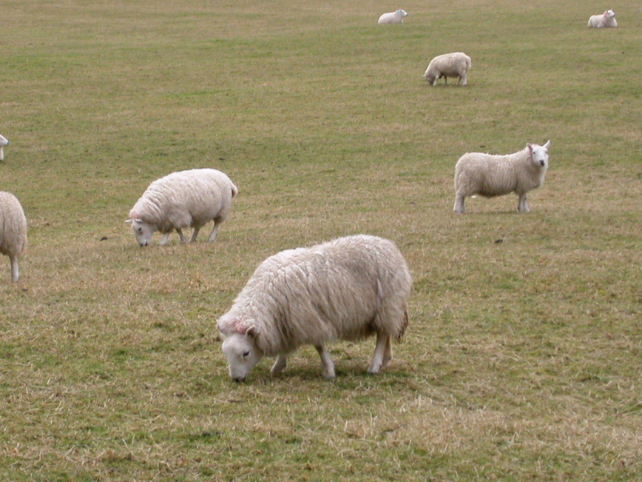
What is a Commons?
Resources shared by some group, either (a) consumed jointly or (b) used as a common pool for private consumption;
These resources can be exhausted or degraded by over-use or under-investment;
Decisions to use or replenish resources may be made by different combinations of stakeholders.
Efforts to maintain or reallocate these resources are costly;
Research of Lin Ostrom & others proves that key stakeholders can work together to craft, monitor, and enforce rules that ensure the continued viability of common resources.
Examples:
Natural resource commons (fisheries, common grazing land, forests);
Constructed commons (irrigation systems, technical infrastructures, information systems, health commons)

Slide 6
Health as a Commons (and Self-Regulation)
Shared resources in medical care:
Time to meet with trained healthcare professionals,
Use of hospitals, clinics & test facilities,
Funds available for health care (insurance, gov. programs).
Limited number of clinicians, hospital beds, dollars, etc.
Decisions on use of different resources are made by different groups of stakeholders.
Reallocation resisted by entrenched interests.
In some communities, multi-stakeholder groups do share responsibility for stewardship.

Slide 7
Who Can Act as Stewards of Common Resources in Healthcare?
Physicians and Other Healthcare Professionals
Administrators of medical facilities
Insurers (Private and Public)
Employers (primarily as purchasers of insurance)
Local government officials (esp. public health)
Community Service Organizations (CSOs)
Health Information Exchanges (HIEs)
Individual Citizens (critical for overall health but limited influence over medical services industry)
7

Slide 8
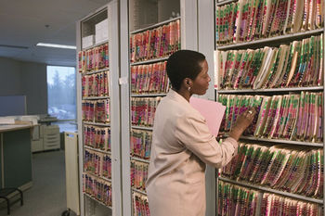
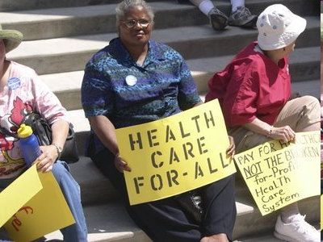
17 Decision Points in Local/Regional Health Care
Built environment
Hospice care
Quality improvements
Chronic care
Electronic records
Mental health care
Environmental Safety
Insurance coverage
Pay for performance
Access to care
Primary care
Construction of new facilities
Hospital consolidation
Wellness Programs
Food deserts
Emergency Care
Care Transitions
Source: Pictures taken from Jack Homer, System Dynamics
Applications at the Federal Centers for Disease Control and Prevention (CDC), May 6, 2009, http://www.chronicdisease.org/files/public/2009Institute_SD_Track_JackHomer_SystemDynamicsApplications.ppt

Slide 9
Critical Challenges to Effective Local Management of the Delivery of Medical Services
Responsibility for preventive care is unclear
Third-party payers insulate consumers from real costs
Technological innovations can increase costs
National and state policies constrain local choices
National market forces and consolidation remove some decisions from local area
No obvious institutional home for regulation
On the plus side: compassion is a resource for reform

Slide 10
Local Stakeholders are NOT Powerless.

Slide 11
Important resource allocation decisions are made in local settings:
Recruitment of physicians and other professionals
Building new facilities
Negotiations among hospitals, physician groups, insurance plans
Quality improvements within organizations
Coordinated care
Patient-clinician interactions
Employer-sponsored health plans
Built environment
Personal choices between healthy and unhealthy behaviors.

Slide 12
Group Exercise: Evaluate ONE of the following decision points, from a local/regional perspective
Built environment
Quality improvements
Hospice care
Chronic care
Electronic records
Mental health care
Environmental Safety
Insurance coverage
Pay for performance
Access to care
Primary care
Construction of new facilities
Hospital consolidation
Wellness Programs
Emergency Care
Food deserts
Care Transitions
Source: Pictures taken from Jack Homer, System Dynamics
Applications at the Federal Centers for Disease Control and Prevention (CDC), May 6, 2009, http://www.chronicdisease.org/files/public/2009Institute_SD_Track_JackHomer_SystemDynamicsApplications.ppt

Slide 13
Recognizing Allocation Decisions and Externalities
For this exercise, please evaluate your topic from the perspective of
a local or regional community (NOT the nation as a whole).
First, discuss your answers to the following questions:
Under current conditions, who is most directly involved in making these decisions?
What are the most difficult tradeoffs they face when making these decisions?
Now discuss these questions:
Which of the other decision points are affected by these decisions?
Given these effects on other parts of the health care system, who do you think SHOULD make these decisions, and on what basis?

Slide 14
Lessons from Group Projects: Participants
Topic | Current Participants | Needed Participants
PHYSICAL FACILITIES: Consolidation, Construction of new facilities | Facility administrators Physicians and Professionals | Community Service Organizations Local Government Officials Employers, Insurers, HIEs
DELIVERY OF CARE: Care Transitions, Chronic care, E-records, Hospice, Mental health care, Primary care, Quality improvements | Facility administrators Physicians and Professionals Health Information Exchanges | Community Service Organizations Local Government Officials Employers Insurers
FINANCIAL ASPECTS: Insurance coverage, Pay for performance, Wellness programs, Access to care | Insurers Employers Facility administrators Health information exchanges | Physicians and Professionals Community Service Organizations Local Government Officials
PUBLIC HEALTH: Built environment, Emergency preparedness, Environmental safety, Food deserts | Local Government Officials Community Service Orgs Facility administrators Employers | Physicians and professionals Insurers Health information exchanges

Slide 15
Lessons from Group Projects: Challenges of Shared Stewardship
Complexity
Low collective efficacy
Reluctance to commit resources
Dangers to vital interests
15

Slide 16
Lessons From Case Studies (Preliminary)
A strong sense of community is not enough; communication is critical.
Local autonomy must be sought and protected.
Keep focused on a few critical goals
Avoid becoming an exclusive group
Use health promotion campaigns to build momentum to tackle the tough issues of facility construction, physician payment, and insurance.
Monitor performance and share information widely.
Partners who misbehave need a way to rejoin group.
Assessment tools needed.
16

Slide 17
Dynamic Process for Shared Stewardship
Communicate
Prioritize and Focus Efforts
Build Confidence
Recruit Partners
Implementation (Commit Resources & Carry Out the Plan)
Monitor and Sanction
Build and Sustain Trust
Reevaluate
17

Slide 18
Practical Steps
Communicate: build multiple social ties and channels of communication; fill convener and coordinator roles
Prioritize and Focus Efforts: develop a common understanding of system; select specific & achievable goals
Build Confidence: begin with programs that can show results quickly; take ownership by asserting autonomy
Recruit Partners: seek external funding but maintain focus on mission; welcome new partners when needed
Implementation: commit resources as promised and carry out plans; maintain coordination while doing so
Monitor and Sanction: gather and share information; graduated sanctions on those who violate agreements
Build and Sustain Trust: protect vital interests of all parties; allow those sanctioned to restore position
Reevaluate: take time needed to evaluate programs; base innovations on local knowledge
18

Slide 19
Sustaining Shared Stewardship
Pre-Requisites
Sufficient physical, human & social capital.
Multiple communication channels.
Local autonomy recognized & protected.
Community identity strong & expandable.
Support
Reinforce
Processes
Define core mission as stewardship.
Maintain focus on specific goals.
Fill convener & coordinator roles.
Group learning generates innovation.
Shared norms support open discussion.
Routine monitoring & measurement.
Sanctions graduated and reversible.
Protect vital interests of stakeholders.
Results
Build success cumulatively.
Develop trust & reinforce it.
Teams craft rules that fit local conditions.
Rules distribute costs & benefits fairly.
Enable

Slide 20
Steps in a Community Self-Assessment Process
Members of local stakeholder groups should evaluate past or ongoing efforts at shared stewardship
Of common resources relevant to one or more key decision points or topical areas,
And ask themselves how many of the facilitating conditions (pre-requisites, processes, results) have been satisfied in those examples.
Then use these answers to identify missing ingredients, or gaps in their preparation for more difficult tasks ahead.
20

Slide 21
Supplemental Slides
This project is part of the ReThink Health initiative (http://www.rethinkhealth.org/), funded by The Fannie E. Rippel Foundation (http://www.rippelfoundation.org/).
For a more detailed version of this presentation, see http://mypage.iu.edu/~mcginnis/healthcommons/IHI_McGinnis_long.pptx
For a justification of treating health as a commons, see http://mypage.iu.edu/~mcginnis/healthcommons/talkingpoints.pdf
For other related presentations and papers, see links at http://mypage.iu.edu/~mcginnis/healthcommons/mhchome.htm
For more on commons research and related theoretical perspectives, see the following slides.
21

Slide 22
Cross-sector collaboration is more likely to be successful when*
linking mechanisms, such as powerful sponsors, general agreement on the problem, or existing networks, are in place at the time of initial formation.
they have committed sponsors and effective champions at many levels who provide formal and informal leadership.
they establish — with both internal and external stakeholders — the legitimacy of collaboration as a form of organizing, as a separate entity, and as a source of trusted interaction among members.
trust-building activities (such as nurturing cross-sectoral and cross-cultural understanding) are continuous.
partners use resources and tactics to equalize power and manage conflict
they combine deliberate and emergent planning.
they [use] resources and tactics [to deal] with power imbalances and shocks.
they have an accountability system that tracks inputs, processes, and outcomes; use a variety of methods for gathering, interpreting, and using data; and use a results management system that is built on strong relationships with key political and professional constituencies.

Slide 23
Cross-sector collaborations are most likely to create public value when they
build on individuals’ and organizations’ self-interests and each sector’s characteristic strengths while finding ways to minimize, overcome, or compensate for each sector’s characteristic weaknesses.
produce positive first-, second-, and third-order effects [achieving goals, generating social capital, creating shared meaning, increasing interaction, and shifting the power distribution].
are resilient and engage in regular reassessments.
Accountability is a particularly complex issue for collaborations because it is not often clear whom the collaborative is accountable to and for what.
Collaborative structure is likely to change over time because of ambiguity of membership and complexity in local environments.
Competing institutional logics are likely within cross-sector collaborations and may significantly influence the extent to which collaborations can agree on essential elements of process, structure, governance, and outcomes.
The normal expectation ought to be that success will be very difficult to achieve in cross-sector collaborations.
*Source: John M. Bryson, Barbara C. Crosby, and Melissa Middleton Stone. 2006.
“The Design and Implementation of Cross-Sector Collaborations: Propositions from the Literature,”
Public Administration Review, 66 (s1), December 2006, pp. 44-55.

Slide 24
Shared Stewardship and Polycentricity
Shared (or collaborative) stewardship is a generalization of collaborative governance:
a term used in public administration to designate situations in which public officials routinely confer with private firms and voluntary organizations in the formation and delivery of public services.
Both terms are specific instances of polycentric governance:
a technical term from institutional analysis (Ostrom, Tiebout, and Warren 1961) designating a complex political system in which
multiple public authorities from overlapping jurisdictions
and agents of relevant private, voluntary, and community-based organizations
govern themselves and all relevant individuals (who may be participating as constituents, managers, employees, volunteers, members, visitors, and/or citizens)
through an ongoing process of mutual adjustment,
within the constraints of general rules and cultural norms.
Polycentric governance provides plenty of opportunities for all interested parties to participate in policy-making and implementation, and facilitates the fine-tuning of rules and procedures to fit distinctive characteristics of local situations.
Polycentricity has been the central focus of research conducted by scholars affiliated with the Workshop in Political Theory and Policy Analysis.

Slide 25
Key References on Commons Theory & Polycentric Governance
Aligica, Paul Dragos, and Peter Boettke. 2009. Challenging Institutional Analysis and Development: The Bloomington School. Routledge.
Cox, Michael, Gwen Arnold, and Sergio Villamayor Tomás. 2010. “A Review of Design Principles for Community-Based Natural Resource Management.” Ecology and Society 15(4):38 http://www.ecologyandsociety.org/vol15/iss4/art38/ES-2010-3704.pdf;
McGinnis, Michael D. 2011. “An Introduction to IAD and the Language of the Ostrom Workshop: A Simple Guide to a Complex Framework,” Policy Studies Journal 39(1) (February 2011): 163-177. [longer version: http://php.indiana.edu/~mcginnis/iad_guide.pdf].
Ostrom, Elinor. 1990. Governing the Commons: The Evolution of Institutions for Collective Action. New York: Cambridge University Press.
_____. 2005. Understanding Institutional Diversity. Princeton, NJ: Princeton University Press.
_____. 2007. “Collective Action Theory.” In The Oxford Handbook of Comparative Politics, ed. Carles Boix and Susan C. Stokes, 186–208. Oxford: Oxford University Press.
_____. 2009. Video, presentation slides, and text of Elinor Ostrom’s Nobel Prize Lecture at http://www.nobelprize.org/nobel_prizes/economics/laureates/2009/ostrom-lecture.html.
_____. 2011. “Background on the Institutional Analysis and Development Framework.” Policy Studies Journal 39(1) (February 2011): 7–27.
Ostrom, Vincent, Charles M. Tiebout, and Robert Warren. 1961. "The Organization of Government in Metropolitan Areas: A Theoretical Inquiry." American Political Science Review 55 (Dec.): 831‑42.
Poteete, Amy, Marco Janssen, and Elinor Ostrom. 2010. Working Together: Collective Action, the Commons, and Multiple Methods in Practice. Princeton University Press.

