Slide 1
IAD and SES Dynamic Flows: Introducing the Program in Institutional Analysis of Social-Ecological Systems (PIASES) Framework Michael D. McGinnis and Elinor Ostrom
Figures from a preliminary draft of a paper
to be presented at 13th Economics of Infrastructures Conference, Delft, Netherlands, April 27-28, 2010
April 3, 2010 Draft
Presented Wednesday, March 24, 2010,
Workshop in Political Theory and Policy Analysis,
Indiana University, Bloomington

Slide 2
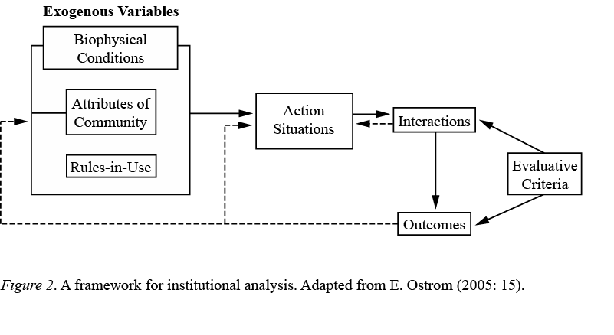
Figure 1: IAD Framework

Slide 3
Figure 1a. Multi-Level Representation of IAD Framework

Slide 4
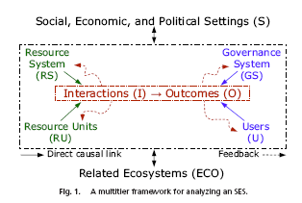
Figure 2a: Components of Ostrom’s PNAS SES Framework (Original)

Slide 5
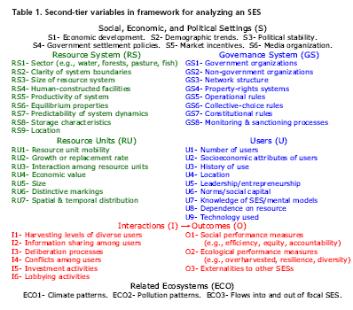
Table 1a. PNAS Framework (original) (Ostrom 2007)

Slide 6
Figure 2: Components of Ostrom’s PNAS SES Framework (Revised)

Slide 7
Fig. 3. Corresponding Components of PNAS and PIASES Frameworks
Dynamics of Social, Economic, and Political Settings
Governance System Dynamics
User Dynamics
Action Situation Dynamics
Focal Resource Dynamics
Resource System Dynamics
Dynamics of Related Ecosystems

Slide 8
Fig. 4. Dynamic Flows in PIASES Framework
Dynamics of Social, Economic, and Political Settings
Governance System Dynamics
User Dynamics
Action Situation Dynamics
Focal Resource Dynamics
Resource System Dynamics
Dynamics of Related Ecosystems

Slide 9
Fig. 5. Flows of Information and Resources into and out of an Action Situation
Information on Group Goals, Strategic Repertoire, and Routine Collective Decisions
Information for Evaluation and Claim-Making
External Actors
Feedback from Endogenously Generated Information
Individuals Observe Information:
(From Endogenous and Exogenous Sources)
Users Take Actions:
1. Appropriation
2. Investment
3. Monitoring
4. Sanctioning
Realize Outcomes:
1. Resource Levels
2. Maintenance
3. Compliance
4. Distribution
Conditions of Focal and Related Resources and Relevant Infrastructure
Resource Extraction and Infrastructure Maintenance
Ecological Feedback and Exogenous Biophysical Influences

Slide 10
Fig. 6. User Group Dynamics
Appeals to External Authorities
Impact of External Actors
Initial Conditions and Knowledge of the SES
Group Formation and Goals
Evaluation and Claim-Making
Learning Loops
Repertoire of Strategies, Norms, Rules, and Positions
Learning Loops
Routine Collective Choices
Routine Adjustments
Information and Actions
Outcomes

Slide 11
Fig. 7. Focal Resource Dynamics
Information and Actions
Outcomes
Availability of Focal Resource
Dynamics of Focal Resource and Infrastructure
(Growth/ Replacement)
Growth/ Replacement
Infra-structure
Initial Knowledge of SES
Effects of Maintenance
Closely Related Resources or Species
Indirect Effects
Exogenous Biophysical Influences
External Effects on Other Ecosystems
Notes:
Key aspects: members of group and their shared goals, what options they have available, leadership and coordination; and then evaluation of results.

Slide 12
Figure 8. Core Dynamics in PIASES Framework
Learning Loops
Initial Conditions and Initial Information
Group Formation and Goals
Repertoire, Rules, Norms, and Positions
Routine Collective Choices
Evaluation and Claim-Making
Information and Actions:
Appropriation, Investment, Monitoring, Sanctioning
Outcomes:
Resources, Maintenance, Compliance, Distribution
Closely Related Resources or Species
Condition of Infrastructure
Availability of Focal Resource
Dynamics of Focal Resource and Infrastructure (Growth/Replacement)
Key: Critical Flows of Resources/Info; Learning Loops

Slide 13
Figure 8a. Core Dynamics in PIASES Framework
Learning Loops
Initial Conditions and Initial Information
Group Formation and Goals
Repertoire, Rules, Norms, and Positions
Routine Collective Choices
Evaluation and Claim-Making
Interactions (Operational Choice): Observe Information;
Appropriation, Investment, Monitoring, Sanctioning
Outcomes:
Resources, Maintenance, Compliance, Distribution
Closely Related Resources or Species
Condition of Infrastructure
Availability of Focal Resource
Dynamics of Focal Resource and Infrastructure (Growth/Replacement)
Key: Critical Flows of Resources/Info; Learning Loops

Slide 14
Figure 8b. Core Dynamics in PIASES Framework
Governance Feedback
Learning
Changes in Collective Procedures
Evaluation
Information & Actions
Inter-actions
Out-comes
Related Resources, Infrastructure
Resource Availability
Resource Growth
Ecosystem Feedback

Slide 15
Figure 9. Full PIASES Framework
Social, Economic, and Political Settings
Governance System Dynamics /
Exogenous Actors
Learning Loops
Initial Conditions and Initial Information
Group Formation and Goals
Repertoire, Rules, Norms, and Positions
Routine Collective Choices
Evaluation and Claim-Making
Interactions (Operational Choice): Observe Information;
Appropriation, Investment, Monitoring, Sanctioning
Outcomes:
Resources, Maintenance, Compliance, Distribution
Closely Related Resources or Species
Condition of Infrastructure
Availability of Focal Resource
Dynamics of Focal Resource and Infrastructure (Growth/Replacement)
Resource System Dynamics /
Related Ecosystems
Exogenous Biophysical Influences
Key: Critical Flows of Resources/Info; Learning Loops; Readily Available Information; Feedback and Exogenous

Slide 16
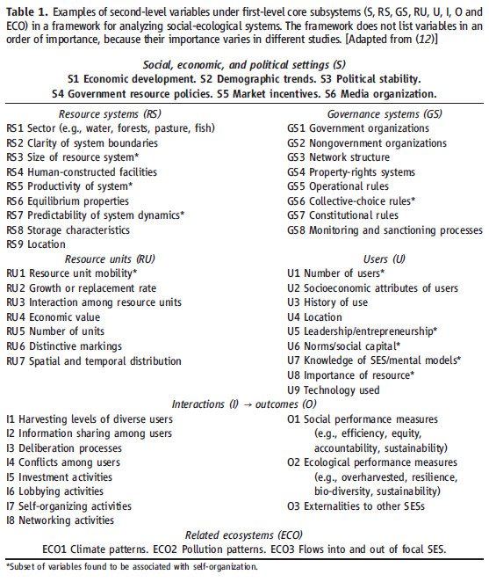
Table 1. Second-Level Variables in PNAS Framework: (Ostrom 2009: 421)

Slide 17
Fig. 10. Initial Effort to Re-Categorize Second-Level Variables from PNAS Framework
S1 Economic development;
S2 Demographic trends
S3 Political stability;
S4 Government settlement
policies
S5 Market incentives;
S6 Media organizations
GS5 Operational rules
GS6 Collective-choice rules
GS7 Constitutional rules
GS8 Monitoring/sanctioning processes
GS1 Government organizations
GS2 NGOs
GS3 Network structure
GS4 Property-rights systems
U1 Number of users
U2 Socioeconomic attributes
of users
U4 Location
U6 Norms/social capital
U7 Knowledge of SES/
mental models
U8 Importance of resource
Local versions of:
GS5 Operational rules
GS6 Collective-choice rules
GS7 Constitutional rules
GS8 Monitoring and
sanctioning processes
U5 Leadership
U3 History of
use
U9 Technology
used
I4 Conflicts
I5 Deliberation
processes
I6 Lobbying activities
I1 Harvesting levels; I2 Information sharing; I5 Investment activities
O1 Social performance measures
O2 Ecological performance measures
RU1 Res. unit mobility
RU3 Interaction among
resource units
RU4 Economic value
RU5 Size
RU6 Distinctive markings
RU7 Spatial/temporal
distribution
RS4 Human-
constructed
facilities
RS8 Storage
characteristics
RS1 Sector
RS2 Clarity of system boundaries
RS3 Size of resource system
RS9 Location
RU2 Growth/replacement rate
O3 Externalities to other SESs
ECO1 Climate patterns;
ECO2 Pollution patterns
ECO3 Flows into and out of focal SES
RS5 Productivity of System
RS6 Equilibrium properties
RS7 Predictability of system dynamics

Slide 18
Fig. 11. Ten Factors Associated with Successful Self-Organization
S1 Economic development;
S2 Demographic trends
S3 Political stability;
S4 Government settlement
policies
S5 Market incentives;
S6 Media organizations
GS5 Operational rules
GS6 Collective-choice rules
GS7 Constitutional rules
GS8 Monitoring/sanctioning processes
GS1 Government organizations
GS2 NGOs
GS3 Network structure
GS4 Property-rights systems
U1 Number of users
U2 Socioeconomic attributes
of users
U4 Location
U6 Norms/social capital
U7 Knowledge of SES/
mental models
U8 Importance of resource
Local versions of:
GS5 Operational rules
GS6 Collective-choice rules
GS7 Constitutional rules
GS8 Monitoring and
sanctioning processes
U5 Leadership
U3 History of
use
U9 Technology
used
I4 Conflicts
I5 Deliberation
processes
I6 Lobbying activities
I1 Harvesting levels; I2 Information sharing; I5 Investment activities
O1 Social performance measures
O2 Ecological performance measures
RU1 Res. unit mobility
RU3 Interaction among
resource units
RU4 Economic value
RU5 Size
RU6 Distinctive markings
RU7 Spatial/temporal
distribution
RS4 Human-
constructed
facilities
RS8 Storage
characteristics
RS1 Sector
RS2 Clarity of system boundaries
RS3 Size of resource system
RS9 Location
RU2 Growth/replacement rate
O3 Externalities to other SESs
ECO1 Climate patterns;
ECO2 Pollution patterns;
ECO3 Flows into and out of focal SES
RS5 Productivity of System
RS6 Equilibrium properties
RS7 Predictability of system dynamics

Slide 19
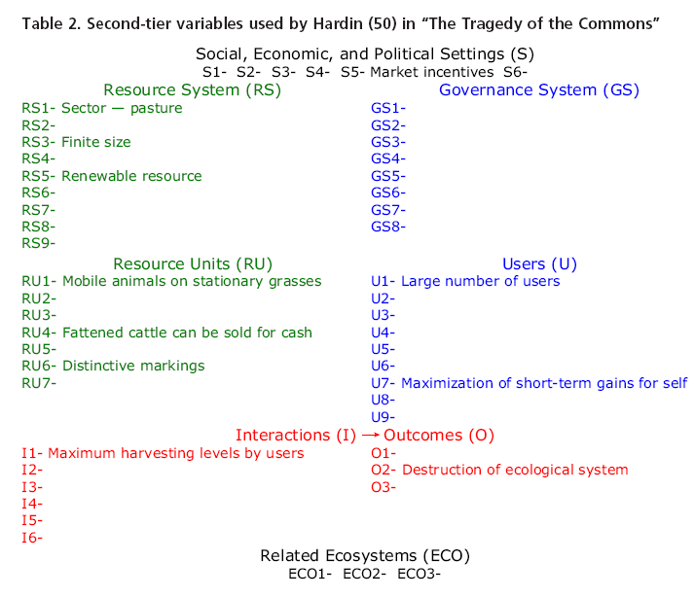

Slide 20
Fig. 11a. Hardin’s Tragedy, Based on Ostrom 2007 PNAS Framework
S1 Economic development;
S2 Demographic trends
S3 Political stability;
S4 Government settlement
policies
S5 Market incentives;
S6 Media organizations
GS5 Operational rules
GS6 Collective-choice rules
GS7 Constitutional rules
GS8 Monitoring/sanctioning processes
GS1 Government organizations
GS2 NGOs
GS3 Network structure
GS4 Property-rights systems
U1 Number of users: Large #
U2 Socioeconomic attributes
U4 Location
U6 Norms/social capital
U7 Knowledge of SES:
Maximize short-term
gains for self
U8 Importance of resource
Local versions of:
GS5 Operational rules
GS6 Collective-choice rules
GS7 Constitutional rules
GS8 Monitoring and
sanctioning processes
U5 Leadership
U3 History of
use
U9 Technology
used
I4 Conflicts
I5 Deliberation
processes
I6 Lobbying activities
O1 Social performance measures
O2 Ecological performance measures
Destruction of ecosystem
I1 Harvesting levels: Maximum by all users; I2 Information sharing; I5 Investment
RU1 Res. unit mobility:
Mobile animals on
stationary grasses
RU3 Interactions
RU4 Economic value:
Sell fattened cattle
RU5 Size
RU6 Distinctive markings
RU7 Spatial/temporal
RS1 Sector: Pasture
RS2 Clarity of system boundaries
RS3 Size of resource system:
Finite
RS9 Location
RS4 Human-
constructed
facilities
RS8 Storage
characteristics
RU2 Growth/replacement rate
O3 Externalities to other SESs
ECO1 Climate patterns;
ECO2 Pollution patterns
ECO3 Flows into and out of focal SES
RS5 Productivity of System: Renewable
RS6 Equilibrium properties
RS7 Predictability of system dynamics

Slide 21
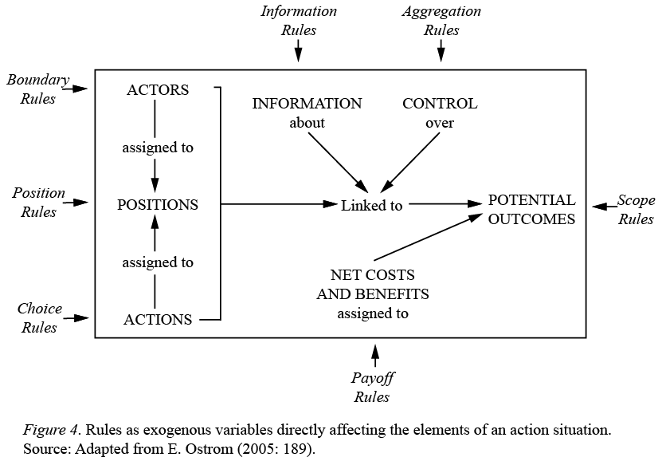
Fig. 12
Working Parts of an Action Situation and Associated Rules (Ostrom 2005: 189)

Slide 22
Fig. 13: Working Parts of Action Situation in PIASES Framework
Governance System Dynamics / Social, Economic, and Political Settings
Learning Loops
Initial Conditions and Initial Information
Group Formation and Goals
Repertoire, Rules, Norms, and Positions
Routine Collective Choices
Evaluation and Claim-Making
Scope (Social Effects)
Boundary (Participants)
Strategies, Norms, Rules, Positions
Expectations
Costs/ Benefits
Choices (appro, invest, mon, sanc) and Endogenous Information
Control over outcomes
Outcomes
Resource Boundary
Information (Exogenous)
Nature of Goods
Closely Related Resources or Species
Condition of Infrastructure
Availability of Focal Resource
Dynamics of Focal Resource and Infrastructure
Scope (Biophysical)
Resource System Dynamics / Related Ecosystems
Key: Critical Flows of Resources/Info; Learning Loops; Readily Available Information; Feedback and Exogenous

Slide 23
Table 2. Dual-Valued Design Principles for Sustainable SES Management
1e. Resource Boundaries: Clear boundaries that separate a specific common-pool resource from a larger social-ecological system are present or can be constructed and maintained at low cost.
2e. Congruence with Local Conditions: Appropriation and provision rules (and especially the associated levels of activities) are congruent with local environmental conditions, especially carrying capacities.
3e. Information for Collective Choice: Most individuals affected by a resource regime have easy access to information about the conditions of the resource.
4e. Monitors who are accountable to or are the users monitor the condition of the resource and other closely related aspects of the relevant ecosystem.
5e. Graduated Degradation and Adjustment: Degradation of the resource starts slow but becomes increasingly noticeable if over-appropriation continues, and rules specify graduated adjustments to be made when degradation becomes noticeable.
6e. Recognition of Ecosystem Conflicts: Tensions with other components of the local ecosystem closely related to the focal CPR are monitored and taken into consideration in governance activities (including revision of appropriation levels).
7e. Minimal Isolation/Insulation from Exogenous Shocks from Nested Ecosystems: When a common-pool resource is closely connected to a larger social-ecological system, the local CPR is not routinely subjected to excessively high levels of variation in necessary support from this ecosystem.
8e. Recognition of Nested Ecosystems: When a common-pool resource is closely connected to a larger social-ecological system, relatively autonomous subunits of these ecosystems can be identified or constructed at low cost.
1s. User Boundaries: Clear and locally understood boundaries between legitimate users and nonusers are present and this distinction is considered valid within relevant cultural contexts.
2s. Congruence of Appropriation and Provision: Appropriation rules are congruent with provision rules in the sense that the distribution of (provision) costs is proportional to the distribution of (appropriation) benefits and resulting inequities are acceptable within relevant cultural contexts.
3s. Collective-Choice Arrangements: Most individuals affected by a resource regime are authorized to participate in making and modifying its rules.
4s. Monitors who are accountable to or are the users monitor the appropriation and provision levels of the users.
5s. Graduated Sanctions: Sanctions for rule violations start very low but become stronger if a user repeatedly violates a rule.
6s. Conflict-Resolution Mechanisms: Rapid, low-cost, local arenas exist for resolving conflicts among users or with officials
7s. Minimal Recognition of Rights and Minimal isolation/insulation from nested enterprises: The rights of local users to make their own rules are recognized by the government and local governance activities are not routinely undermined or overwhelmed by external actors (corporations or governments or international NGOs)
8s. Governance by Nested Enterprises: When relatively autonomous subunits of larger ecosystems can be identified, governance activities are organized in multiple nested layers or new arenas can be constructed at low cost.

