Slide 1
Highlights
Overview of sabbatical activities
Michael D. McGinnis, Ph.D.
Visiting Faculty, Dartmouth Center for Health Care Delivery Science
and Dartmouth Institute for Health Policy and Clinical Practice,
Professor, Political Science and Senior Research Fellow,
Ostrom Workshop, Indiana University, Bloomington,
Core Faculty, ReThink Health, Rippel Foundation
mcginnis@indiana.edu
Notes:
For TDC staff meeting and ?

Slide 2
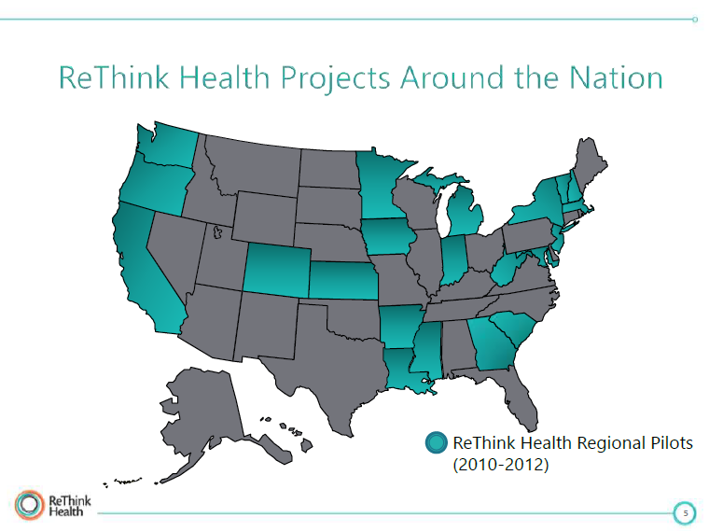
Notes:
I’m here primarily under auspices of RTH
Grand Junction
Cedar Rapids
Bloomington
Upper Valley

Slide 3
RTH Upper Valley: Initial Planning Team members
Barbara Couch – VP Corporate Social Responsibility, Hypertherm
Elliott Fisher – Director, The Dartmouth Institute for Health Policy and Clinical Practice
Sara Kobylenski – Executive Director, The Upper Valley Haven
Laura Landy – President & CEO, The Fannie E. Rippel Foundation, and member, Dartmouth-Hitchcock Board of Trustees
Gregg Meyer – Chief Clinical Officer and Executive Vice President for Population Health, Dartmouth-Hitchcock Medical Center
Al Mulley – Director of the Dartmouth Center for Health Care Delivery Science
Gene Nelson – Director of Population Health and Measurement at The Dartmouth Institute and at Dartmouth-Hitchcock Medical Center
Steve Voigt – President & CEO, King Arthur Flour
ReThink Health facilitators
Kate Hilton, JD, MTS – Community Organizing & Mobilizing for Action
Sherry Immediato, MPP, MBA –Organizational Learning & Large System Change
Mike McGinnis, PhD – Shared Governance of Common Resources
Erin Pichiotino, MPH – Project Coordinator, ReThink Health
Ruth Wageman, PhD – Leadership Development & Multi-Stakeholder Team Effectiveness
Notes:
Plus local staff, Sarah, and Erin going over to TDI, more to be hired

Slide 4
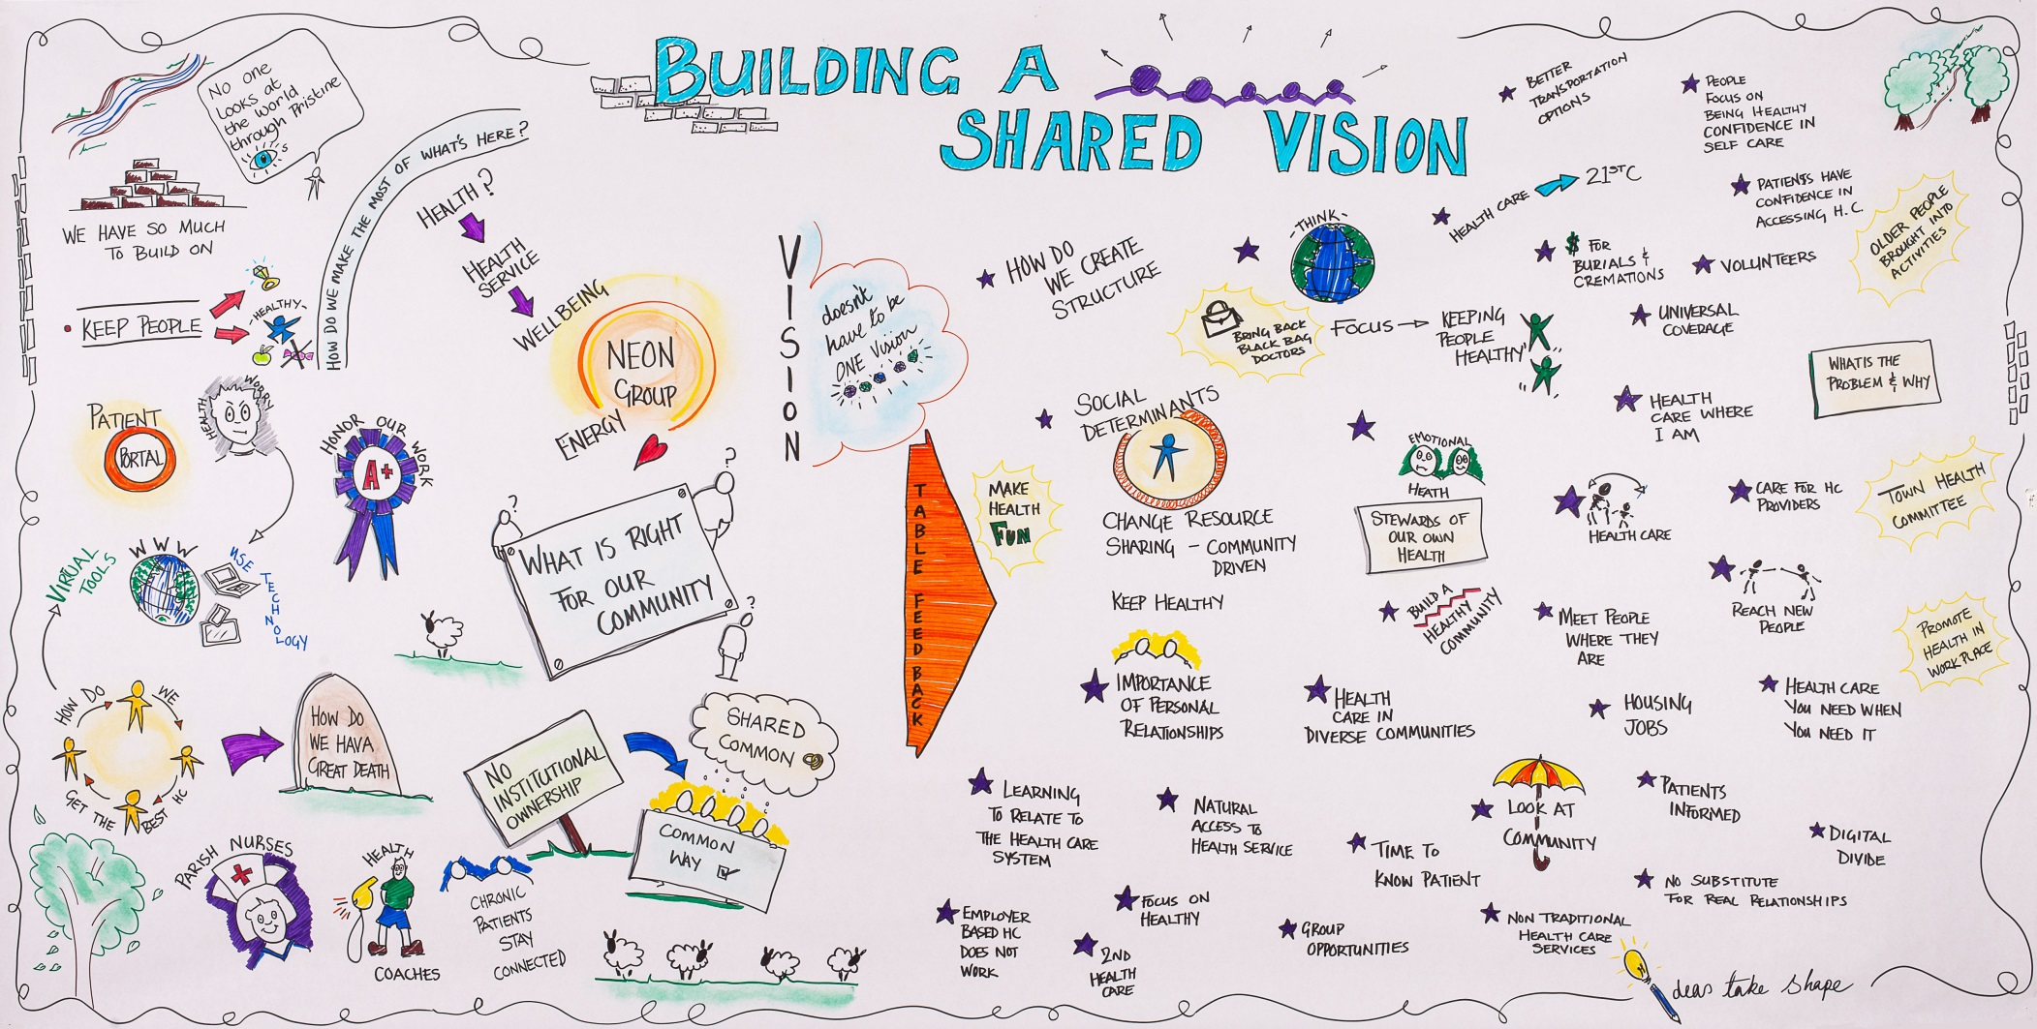
Visioning at Inaugural Convening, April 30, 2013
Notes:
Graphic artist in residence
Began with vision of Greg Mayer and Sara Kobylenski
Remember – will return later

Slide 5
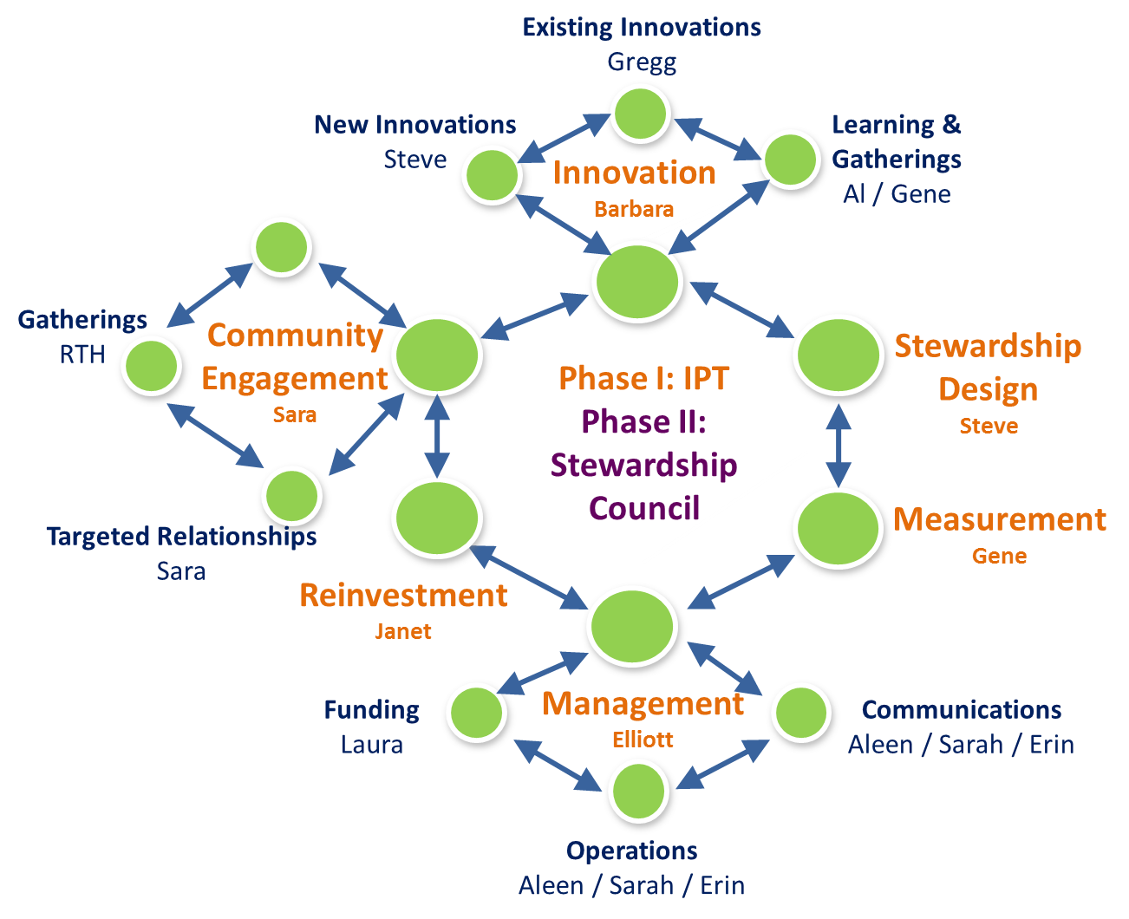
Draft Snowflake Organizing Structure for Upper Valley Project
Notes:
I work primarily with HSD and Measurement
RTH colleagues advise on whole structure

Slide 6
ReThinking Health: Leadership Essentials in a Changing System: 8-Week Distance Learning Course
Notes:
8 step training program
I did module 5, based on paper
Two others should be familiar to Master’s class:
Bobby did model in 4
Ruth leadership teams in 6
Participants include several from Upper Valley

Slide 7
Notes:
RTH vision
Criteria beyond Triple Aim and even Quintuple Aim
Each of the 11 red items on last slide have 3 possible steps
Course participants did self-assessments
Arrow suggests movement towards better coordination on one or more dimensions
Based on artwork by S Carolina artist
Integrated and directed allows for lots of different forms of institutional arrangements

Slide 8
Institutional Diversity in (More-or-Less) Integrated Regional Systems of Health Care Delivery
No regular discussions among all key stakeholders (Bloomington, IN)
Informal consortium of community leaders (Grand Junction)
Bottom-up initiatives building towards broader discussions (South Carolina RTH group)
Regular meetings sponsored by a non-profit organization (Network of Regional Health Improvement Collaboratives)
Multi-Stakeholder Cooperative (Health Partners, MN, and possible future for Upper Valley?)
Accountable Care Community (Akron, Whatcom County)
Fully integrated system (Kaiser Permanente, Geisinger)
Association of Diverse Collaboratives (High Value Health Collaborative)
Notes:
During my sabbatical I had hoped to find a way to classify cases of integrated delivery systems
Found literature on it, but nothing very compelling
Decided to shift focus to broader set of issues facing all regions: governance
Index to measures of effective polycentricity?

Slide 9
Why We Call it Stewardship
To me this is a problem of governance, but I’ve been advised to avoid that word (too close to government)
Governance is a process involving many kinds of public, private, & voluntary organizations, whereas governments are public organizations, but this distinction is not widely recognized
Government evokes partisan stand-taking, governance requires integrated leadership
Stewardship a more appealing term, but not ideal either;
“the conducting, supervising, or managing of something; especially: the careful and responsible management of something entrusted to one's care.” (Merriam-Webster on-line dictionary).
Most easily understood by religious groups or by environmentalists.
Multi-stakeholder collaboration is key to shared stewardship of a regional health commons.

Slide 10
Commons and Common Property
A commons is any collection of natural or constructed resources that is available for use by some group.
Requires replenishment of stock and/or construction & maintenance of infrastructure.
If too many resources are extracted, or too few resources used for replenishment/infrastructure, result may be depletion or destruction (tragedy of the commons)
Hardin (1968) saw only two solutions: privatization or central control
If a group agrees to work together to manage common resources jointly, then it becomes common property.
Rules that restrict extraction levels and contributions may be written, monitored, and/or enforced by political authorities and/or by group members (subject to limits set by higher political authorities).
Elinor Ostrom (2009 Nobel Memorial Prize in Economic Sciences) established eight Design Principles that support sustainability of community-managed resource commons (i.e., common pool resources managed under a common property regime)
Notes:
Health commons began as loose analogy to research on resource commons
Distinguish roles
Those using the resource
Those involved in construction and/or replenishment/maintenance
Those involved in managing resources, setting and enforcing rules

Slide 11
Exploring Health Commons at Multiple Levels
The concepts of a commons, and of common property, can be applied at several levels of aggregation in the overall system of health and health care delivery:
Program Commons (or Micro-Commons)
Specific projects or programs (example: suicide hot-line)
Clusters of closely related programs (counseling services)
Broad topical categories (mental and behavioral health, access to care, built environment)
Regional Health Commons (system comprised of all the physical, financial, human, and social capital relevant to health care and/or population health in that region)
Fiscal Commons at state or national levels (total financial resources available for public services, with health care as one claimant among many)
Notes:
Disentangling these took a long time, still inter-related in complex ways
Berwick mixed 2 and 3, 3 not very conducive to a solution, and 2 not easy to interpret
Micro-commons idea came from Jeff Kuhr, GJ
See paper for detailed translation of terms from natural resource commons into these health-related examples

Slide 12
Examples of Relevant Commons
Type & Level of Commons | Users or Production Functions | Builders of Common Resource | Managers and/or Stewards
Natural Resource (sheep) | Sheep graze on grass, produce wool & mutton | [Nature]; Herders put sheep in common pasture | None; or (a) state, (b) private property owners, or (c) user group (herders)
Constructed Physical Resource (irrigation system) | Farmers using irrigation water | Construction firm Farmers | None; or Government agents, Farmers association
National Fiscal Commons | Medical-Industrial Complex, other claimants | National economy and public budgets | National politicians (???????????????)
Regional Health System (traditional) | Patients and Providers (hospitals, physicians insurance, etc.) | Providers | -- No obvious candidate for this role – (except in a fully integrated delivery system)
Regional Health Commons (lots of collective action) | Programs transform resources into better healthcare and/or health | Providers involved in each program | None; or stewardship team involving all key stakeholders
Micro-commons (service delivery) | Direct beneficiaries | Providers define program, rules | Providers, with external regulation and contract enforcement
Micro-commons (Co-Production) | Beneficiaries & Providers | Beneficiaries & Providers | Stewardship team, with beneficiaries & providers
Notes:
Natural Resources: Sheep vs. Irrigation Farmer versions of commons (natural vs. constructed)
Sheep minimally involved in governance
Irrigation farmers may be intimately involved, or not,
Lin’s research on Nepal showed better result if farmer-managed than agency-managed
Even if technology of system is lower
Micro-commons level, clear distinction between sheep and irrigation analogies
At regional level, build on basis of sheep or irrigation example?

Slide 13
Translating Design Principles to Healthcare Settings
Specific Examples from Grand Junction | Design Principles (Elinor Ostrom) | General Guidelines for Regional Stewardship*
Financial Pool to Equalize Payment and Build Withhold Pool | Clear Boundaries | Align Stakeholder Plans to Community Values
Peer Review of Physicians | Routine Monitoring | Gather and Share Information
Marillac Clinic, Hospice, Home Care | Build Nested Enterprises | Nurture Innovation
B4 Babies and Beyond | *Long-Term Horizon* | Think Systemically
Quality Health Network | Wide Participation | Build Momentum
PCP Recruitment | Congruence to Local Conditions and Values | Recognize Local Challenges
FTC Consent Decree | Recognized Autonomy | Establish Shared Priorities
Mentoring and Informal Pressure | Graduated Sanctions | Hold Each Other Accountable
Local Committee | Dispute Resolution | Address Inequities
Commitment by CEOs | *Trusted Leaders* | Find a Trusted Convener
* See next slide for additional requirements
Notes:
Conclusion from my paper,
Added two principles to Lin’s list, because not so easy to assure in health care sector
GJ examples for micro-commons
misleading because each would need all of the conditions satisfied for sustainability
Ensuring sustainability of high-priority programs was key to foundation of GJ success
Ordered in table by rough chronology, through PCP recruitment
Regional commons list sounds suspiciously familiar from literature
Needs to be supplemented

Slide 14
Design principles/guidelines for shared stewardship need to be grounded in and supported by enabling conditions at several levels:
Characteristics of individual leaders: collaborative, innovative, systems thinking
Processes within leadership teams (openness of communication, shared understanding)
Stakeholder organizations with interests aligned to community values
Enabling conditions at regional and national levels, esp. sufficient resources and room for local autonomy
Notes:
RTH training or engagement programs include attention to all these enabling conditions
Natural connection to broader literatures on leadership, organizations, innovation, public policy/administration
Most of these themes covered in MHCDS and/or RTH

Slide 15
Health Policy and Governance
Health policy tends to be seen as something that happens TO citizens and providers, and not something under their control
A disturbing lack of efficacy even among health care professionals
Health policy is not just about economic incentives or regulations!
Each region has some form of health governance, some system of institutions for health promotion and delivery of health care
Health governance suffers from “missing institutions,” especially
Transparency in costs and the selection of community priorities
Routine multi-stakeholder collaboration across health care specialties and with public officials and community leaders, and between public health officials and provider organizations
Sustained communication between providers and patients (and their social support networks)
Actors with an encompassing interest or long-term perspective on how health and health care affect the prosperity of the region as a whole
We can draw on lessons from the public administration literature, which now sees public officials as being embedded within cross-sector networks
Notes:
Dig deeper on governance issues, not covered much in MHCDS
Confront reality of governance, even if not in explicit form
Missing institutions theme a generalization of “missing market” explanation preferred by economists
To build missing markets you often need to add institutional support

Slide 16
Polycentric governance (V. Ostrom, Tiebout, and Warren 1961) designates a complex political system in which
multiple public authorities from overlapping jurisdictions, both general purpose jurisdictions (at all levels of federal system) and special purpose, cross-jurisdictional political units (special districts)
& agents of private, voluntary, and community-based organizations
govern themselves and others through an ongoing process of mutual adjustment,
within the constraints of general rules and cultural norms.
Polycentric governance provides opportunities for participation in policy-making and implementation, and facilitates the fine-tuning of rules and procedures to fit characteristics of local situations.
Notes:
Public administration literature provides list of hypotheses, but no compelling classification schemes
So by default I went to my favorite one, polycentricity,
Core concept of Ostrom Workshop

Slide 17
Building a Governance System on Existing Successes
In a regional health care delivery system, many micro-commons operate simultaneously.
Each program was established for a specific reason that some providers and payers found compelling, but
Some programs may later experience mission drift,
Programs can compete for funding, and may either complement or reinforce each other’s effectiveness,
Many gaps will remain uncovered, specifically those lacking key ingredients for getting a program started, and
Funding agencies and government programs change priorities often, and often capriciously.
If, as is usual, no one is in charge at this level, we should expect to see only more fragmentation.
But even minimal levels of stewardship can begin to more effectively knit these programs together.
Notes:
All communities have some programs, potential basis for transformation

Slide 18
Minimal Requirements for Stewardship
To be effective, in any setting, stewards need to
Meet regularly and speak honestly to build and maintain trust,
Build a shared vision and assign priorities to programs and challenges,
Allocate resources (either individually or collectively) to support game plan,
Monitor consequences, and revise plans and programs when necessary.
All these factors are emphasized in all ReThink Health engagements with regional communities
Notes:
Minimal requirements inspired by GJ example, built up over long period of time
For #3, RTH emphasizes importance of capturing and reinvesting savings

Slide 19
Polycentric Contexts for Care across the Continuum (P3C) (inspired by Upper Valley discussions)
A system of complementary options across entire continuum of care
When healthy: easy access to health information & preventive health (workplace, pharmacies, schools, etc.)
When concerned about specific problem: mental and behavioral care counseling, more general counseling
When need 1st contact: 24/7 access (virtual & urgent care)
Primary care options: physicians, PCMH teams, nurse practitioners, iphone doctors)
Acute care: comparative data, shared decision-making
Chronic care: multiple clinics, in-home monitoring
Palliative care: nursing homes, hospice, in-home care
Community discussion and stewardship: public forums, web portals, and leadership meetings
System should combine virtual and personal contact in each context, and should actively engage many others beyond usual suspects (providers, payers, insurance)
Notes:
My version of Greg and Sara’s vision (slide 4)
Not yet shared with IPT

Slide 20
Challenges of Realizing Polycentric Care
Information and time requirements
Coordination costs
How can partisan entanglement be reduced, given
Medicare benefits are big contributor to federal deficit
Medicaid is key contributor to state financial problems
State insurance exchanges, but will lack of full adoption lead to national exchange?
Need a vision: an inspiring public articulation of the foundational values upon which reform should be built
Some combination of choice, individual responsibility, local autonomy, equity, free enterprise, professional ethics, innovation, and basic human decency.
Building and sustaining a sense of (personal & professional) efficacy in face of so much complexity
Notes:
Oscar Wilde: “he problem with socialism is that it will take up too many evenings”
Find institutions the reduce unnecessary transaction costs and that enhance benefits of cooperation (or innovation)
Focus on practical problem-solving and not partisan point-scoring
Vision is a tough nut to crack; has to transcend partisanship
Building efficacy is key goal of both RTH and MDCHS

Slide 21
Lessons for National Policy
Encourage more autonomy at regional level
Allow more flexibility in institutional arrangements; ACO requirements too constraining for some regions
Allow more latitude in reaching goals for coordination
Shift funding to block grants, esp. to regional collaborations
Encourage local collaborations to capture and reinvest savings
Encourage closer connections between public health officials and health care executives
ACA takes some initial steps with requirement for hospitals to work with community organizations and public health on community needs assessments
Learn from previous failures to establish region-wide planning agencies or procedures
Notes:
Context insisted on by George Mason colleagues
Locus of action should be at local/regional level
Last line on slide might be a good basis for my own personal research program

